Slide 1



“This project has been funded with support from the European Commission. This communication reflects the views only of the author, and the European Commission and Spanish National Agency cannot be held responsi­ble for any use which may be made of the information contained therein”
Nutritional Label Analysis: A Practical Workshop for VET Students and Young Adults
Food for thought: Nourishing mental well-being in vocational training
Erasmus+ 2025-1-ES01-KA210-VET-000358116

Slide 2
Food for thought: Nourishing mental well-being in vocational training
Erasmus+ 2025-1-ES01-KA210-VET-000358116
- Food4Thought -
WP 2. Cultivating Healthy Lifestyles: Analyzing Nutritional Habits of VET Students and Young Adults
Task 2.2. Nutritional Label Analysis

Slide 3
Why Nutritional Labeling?
Food labeling is a primary mean of communication between the producer, seller and the final consumer of a food product.
Nutrition label is considered as an ideal vehicle for conveying dietary guidance/information about the nutrition attributes of food products (Nusrath Nasir, 2013).
The regulations stipulate the requirements for 3 different types of nutrition information on food labels.
Nutrition Facts table
Nutrient content claims: e.g. low in saturated fat, low in sodium.
Diet-related health claims: e.g. reduce risk of high blood pressure, heart disease.
Food for thought: Nourishing mental well-being in vocational training
Erasmus+ 2025-1-ES01-KA210-VET-000358116

Slide 4
Purpose of Nutritional Labeling of Food
How do I use the nutrition information of food labels for a healthy eating context?
Nutritional food labels offer you information about which nutrients are in the food product.
Food labels don’t suggest what foods to eat - that’s your decision ... but labels can help you make your “personal best” food choices.
Nutritional labeling can make significant impact on consumer health through declarations of certain nutrients such as: Polyunsaturated fatty acids, omega-3, fiber, trans fats, cholesterol, sodium etc.
Food for thought: Nourishing mental well-being in vocational training
Erasmus+ 2025-1-ES01-KA210-VET-000358116

Slide 5
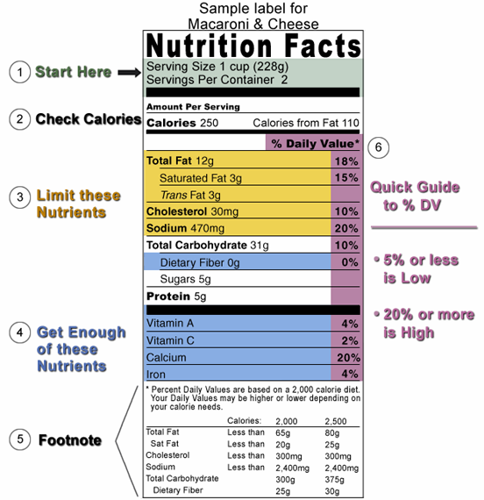
Nutritional Information
Food for thought: Nourishing mental well-being in vocational training
Erasmus+ 2025-1-ES01-KA210-VET-000358116

Slide 6
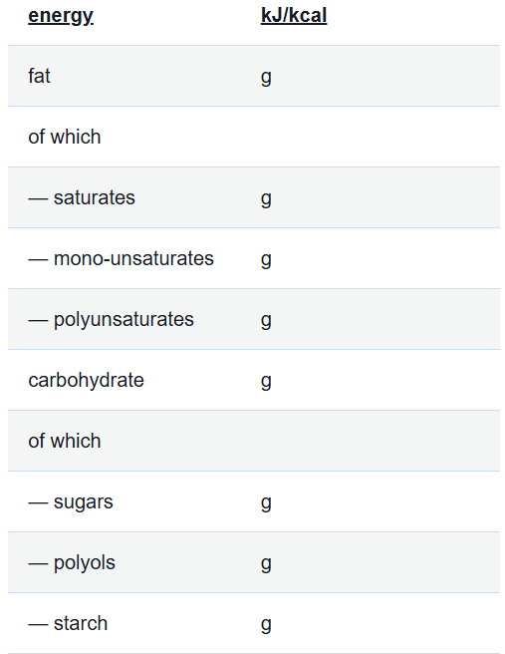
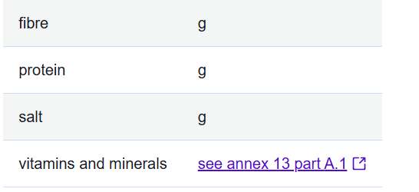
What nutritional information is listed on the label?
* According to Regulation (EU) No 1169/2011 of the European Parliament and of the Council of 25 October 2011 on the provision of food information to consumers available on https://eur-lex.europa.eu/legal-content/EN/TXT/?uri=CELEX:32011R1169#d1e32-61-1
Food for thought: Nourishing mental well-being in vocational training
Erasmus+ 2025-1-ES01-KA210-VET-000358116

Slide 7
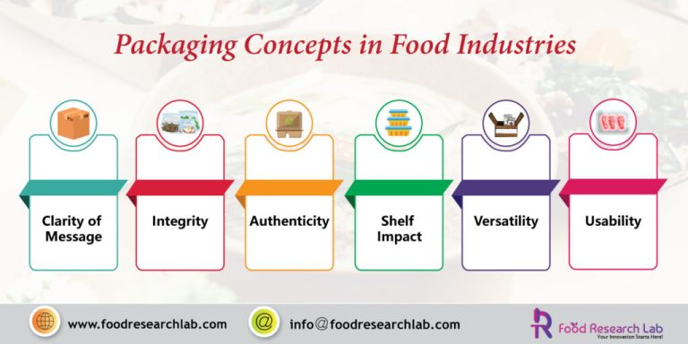
Food packaging aids and enhances convenience for consumers.
Not only that, the right type of packaging will gain additional shelf life to your product if processed and packaged at optimal conditions.
Food for thought: Nourishing mental well-being in vocational training
Erasmus+ 2025-1-ES01-KA210-VET-000358116

Slide 8
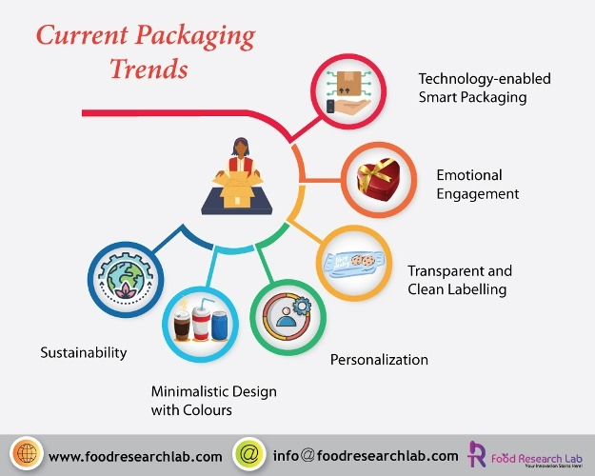
Source: https://www.foodresearchlab.com/blog/new-food-product-development/food-packaging-concepts-and-trends/
Food for thought: Nourishing mental well-being in vocational training
Erasmus+ 2025-1-ES01-KA210-VET-000358116

Slide 9
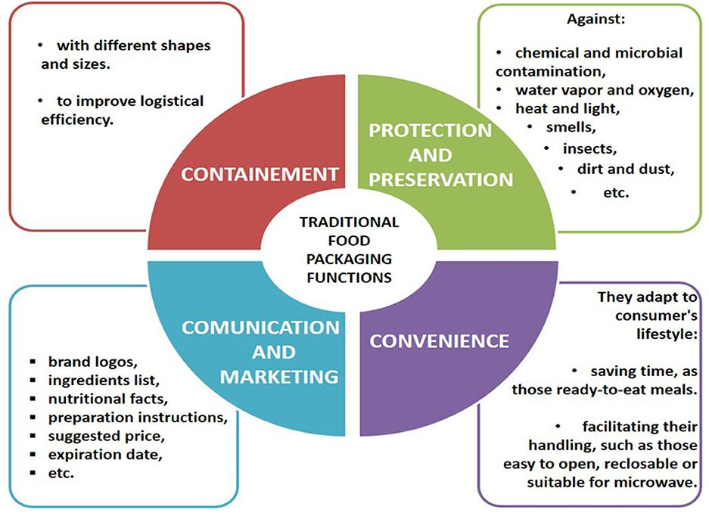
Food for thought: Nourishing mental well-being in vocational training
Erasmus+ 2025-1-ES01-KA210-VET-000358116

Slide 10
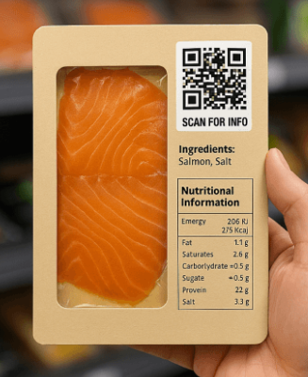
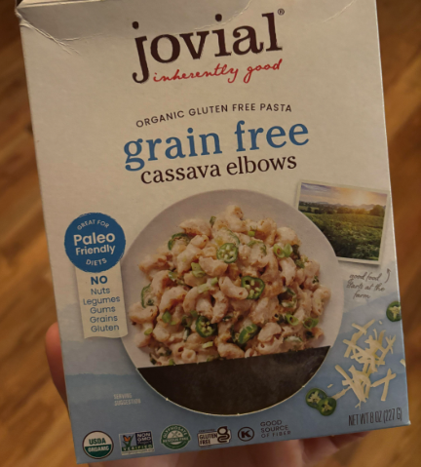
Clarity of message
Shoppers often make their decision in one-third of a second and they can become frustrated if the food packaging design makes it difficult to choose a product.
The product becomes successful when the end consumer can understand the brand, the product and the packaging design.
Food for thought: Nourishing mental well-being in vocational training
Erasmus+ 2025-1-ES01-KA210-VET-000358116

Slide 11
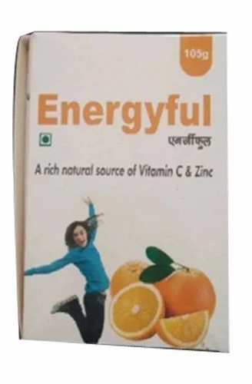
Integrity
If the consumers have bought the product once, it is essential for the producer to deliver the same quality of each product lot, in order for the consumer to buy it again and again. They have to trust your brand which is based on the integrity of your intact product.
A false expectation should not be created by using dramatically edited images that will not meet the consumer expectations.
Food for thought: Nourishing mental well-being in vocational training
Erasmus+ 2025-1-ES01-KA210-VET-000358116

Slide 12
Authenticity
TO DOs … use common colours and materials that suit your product. For instance, if your product is about natural foods, then choose earthen primary colours which will appeal better.
Moreover, this authentic style of packaging should be consistent with your brand products.
Research has shown colours can be effective to grab customers focus and attention. For instance, red, green, yellow and pink are the most eye-catching colours.
Food for thought: Nourishing mental well-being in vocational training
Erasmus+ 2025-1-ES01-KA210-VET-000358116

Slide 13
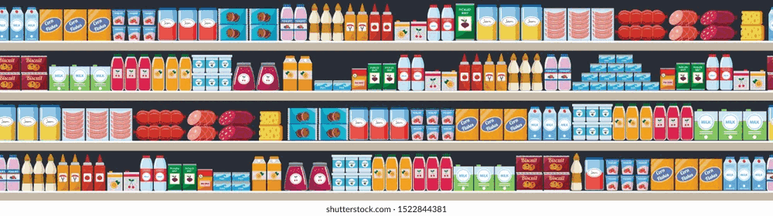
Shelf impact
Food retailers also think about the food packaging design, because they are displayed on the shelves to attract customers and this is called shelf impact.
Product placement is done based on the product looks and patterns that they create.
Products that are placed next to a certain product can change the perception of consumers leading to both an increase or decrease in their sales.
Food for thought: Nourishing mental well-being in vocational training
Erasmus+ 2025-1-ES01-KA210-VET-000358116

Slide 14
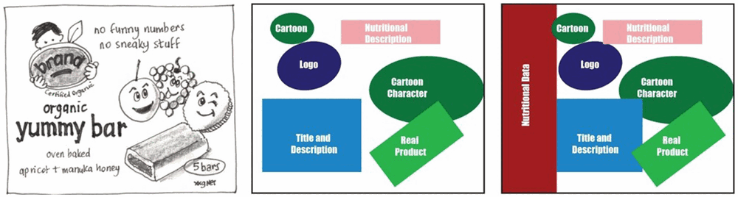
Figure 1. Illustrated image of child snack bar product (L) with elements highlighted with color (C) and proposed 25% of the pack dedicated to nutrition information (R).
Food for thought: Nourishing mental well-being in vocational training
Erasmus+ 2025-1-ES01-KA210-VET-000358116

Slide 15
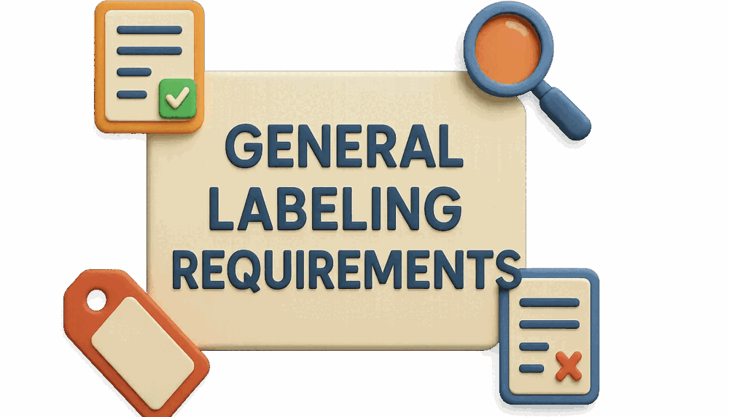
General Labeling Requirements
Five mandatory components must be on a food label:
Product Identity
Net Weight
Nutrition Facts
Ingredient Statement
Place of Business
This information may be located on the Principle Display Panel (PDP) or Information Panel.
Food for thought: Nourishing mental well-being in vocational training
Erasmus+ 2025-1-ES01-KA210-VET-000358116

Slide 16
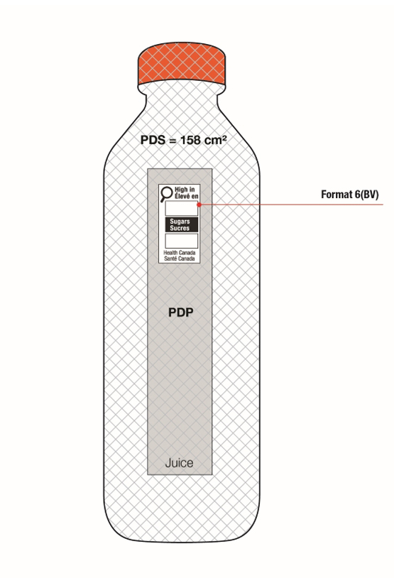
Principle Display Panel (PDP)
The PDP is the surface area you are able to see while walking down the grocery store aisle.
The height times the width of the PDP determines the type size requirement of the food label.
  On cylindrical containers, the surface area of the PDP can be calculated by multiplying 40 percent of the height by the circumference.
The PDP must include two pieces of information:
  Statement of identity, or name of food
  Net quantity statement, or amount of product
Food for thought: Nourishing mental well-being in vocational training
Erasmus+ 2025-1-ES01-KA210-VET-000358116

Slide 17
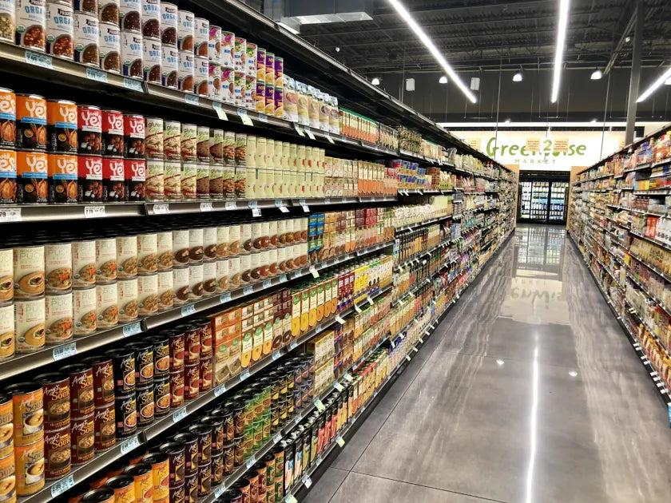
PDP Display
Food for thought: Nourishing mental well-being in vocational training
Erasmus+ 2025-1-ES01-KA210-VET-000358116

Slide 18
Statement of Identity
The statement of identity is the common or usual name of the product contained in the package (e.g. “soup” or “cereal”).
If no common name is given, then a descriptive name may be used in place (e.g. vanilla wafers).
The product identity is required in the middle portion of the PDP’s front label.
  It should be dominant and stand out from all other print and pictures on the package.
Food for thought: Nourishing mental well-being in vocational training
Erasmus+ 2025-1-ES01-KA210-VET-000358116

Slide 19
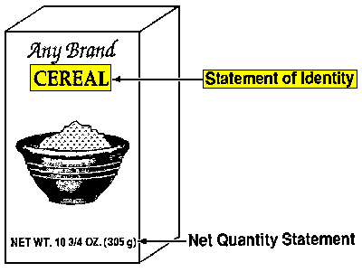
Statement of Identity Example
Food for thought: Nourishing mental well-being in vocational training
Erasmus+ 2025-1-ES01-KA210-VET-000358116

Slide 20
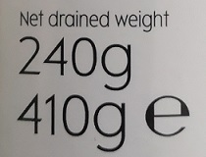
Net Quantity Statement
This statement provides the amount of food in the container or package.
Located in the lower 30 percent of the PDP
Often at the lower right corner of the front label
Only the quantity of food in the package is stated in the net quantity statement
The weight of the container, wrapping and packing material may not be included.
Food for thought: Nourishing mental well-being in vocational training
Erasmus+ 2025-1-ES01-KA210-VET-000358116

Slide 21
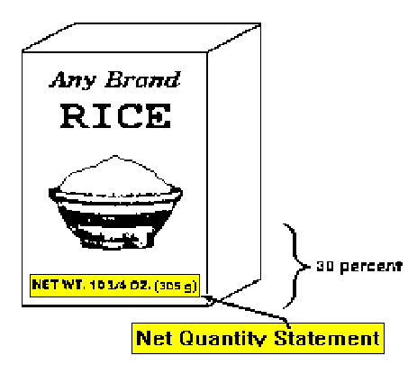
Net Quantity Statement Example
Food for thought: Nourishing mental well-being in vocational training
Erasmus+ 2025-1-ES01-KA210-VET-000358116

Slide 22
Information Panel
The information panel is the surface area normally to the right of the PDP.
This would be the label on the right side of the box.
The information label on a jar would be directly to the right of the PDP.
On the information panel, we find:
  Nutrition Facts
  Ingredient statement
  Place of business
Food for thought: Nourishing mental well-being in vocational training
Erasmus+ 2025-1-ES01-KA210-VET-000358116

Slide 23
Information Panel
Nutritional Facts
PDP
Information Panel
Ingredients
Manufactured by
Food for thought: Nourishing mental well-being in vocational training
Erasmus+ 2025-1-ES01-KA210-VET-000358116

Slide 24
The Ingredient List
Lists all of the ingredients for a food by weight, from the most to the least.
Is a source of information for certain nutrients.
Is a source of information for people with food allergies.
Example:
INGREDIENTS: WHOLE GRAIN ROLLED OATS, SUGAR, HIGH MONOUNSATURATED CANOLA OIL, ALMOND PIECES, RAISINS, GOLDEN SYRUP, SALT, CRISP RICE (RICE FLOUR, SOY PROTEIN, SUGAR, MALT, SALT), SOY LECITHIN, NATURAL FLAVOUR
Food for thought: Nourishing mental well-being in vocational training
Erasmus+ 2025-1-ES01-KA210-VET-000358116

Slide 25
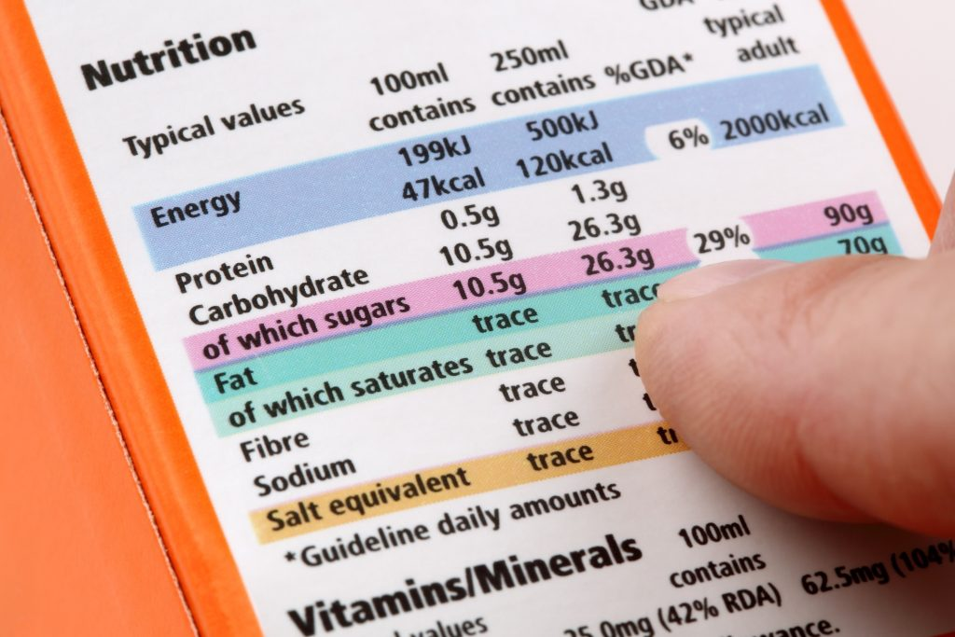
Nutritional profile (Reg. 1924/2006, art. 4)
Concerns about claims
Not to mask the nutritional value of the food through the health claim, in general.
As nutritional profiles have not been clearly established in the EU, there are no maximum reference values ​​for nutrient categories that would condition the use of a claim, leaving room for subjective interpretations
!!! In the US clear specifications: a claim related to fiber and heart health can only be used if the product in question contains less than 3% fat, of which less than 1.5% are saturated.
Food for thought: Nourishing mental well-being in vocational training
Erasmus+ 2025-1-ES01-KA210-VET-000358116

Slide 26
Nutritional content (Reg. 1169/2011)
the nutritional declaration refers to the energy value and the quantity of certain nutrients (fats, unsaturated fats, carbohydrates, sugar, proteins, fibres, salt) and has been mandatory since December 2016;
the novelty is fibres nutritional options can also be identified by the consumer through a logo (it is considered a mention, if it is based on known nutritional profiles); they are not harmonised, but if used they must be in accordance with the regulation
Food for thought: Nourishing mental well-being in vocational training
Erasmus+ 2025-1-ES01-KA210-VET-000358116

Slide 27
Health claims
General claims about benefits to overall good health, such as ‘healthy’ or ‘good for you’, will only be allowed to be used if accompanied by an approved claim.
This means that have an explanation of why the food is ‘healthy’.
Labels are not allowed to claim that food can treat, prevent or cure any disease of medical condition. These sorts of claims can only be made of licensed medicines.
Examples of health claims include:
Calcium is important for normal growth and
development of bones.
Beta-glucans from oats help to reduce cholesterol.
Xylitol in some sugar-free chewing gum helps
to neutralise plaque acids.
Food for thought: Nourishing mental well-being in vocational training
Erasmus+ 2025-1-ES01-KA210-VET-000358116

Slide 28
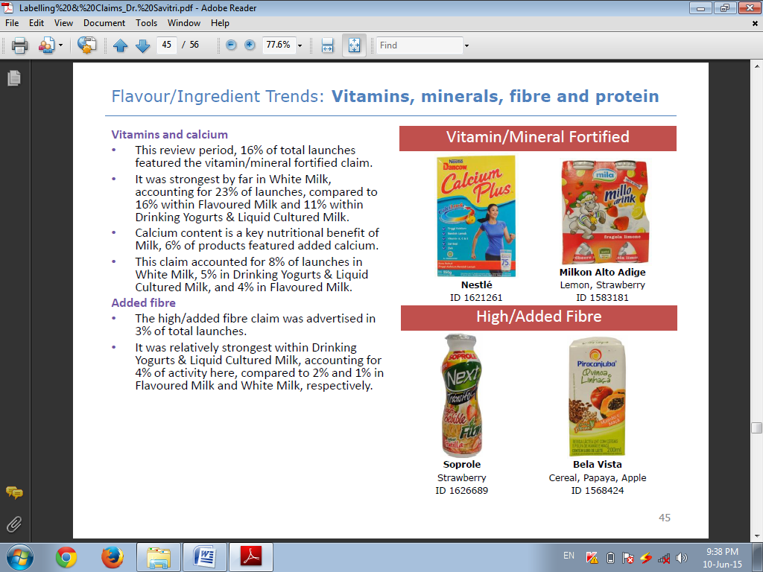
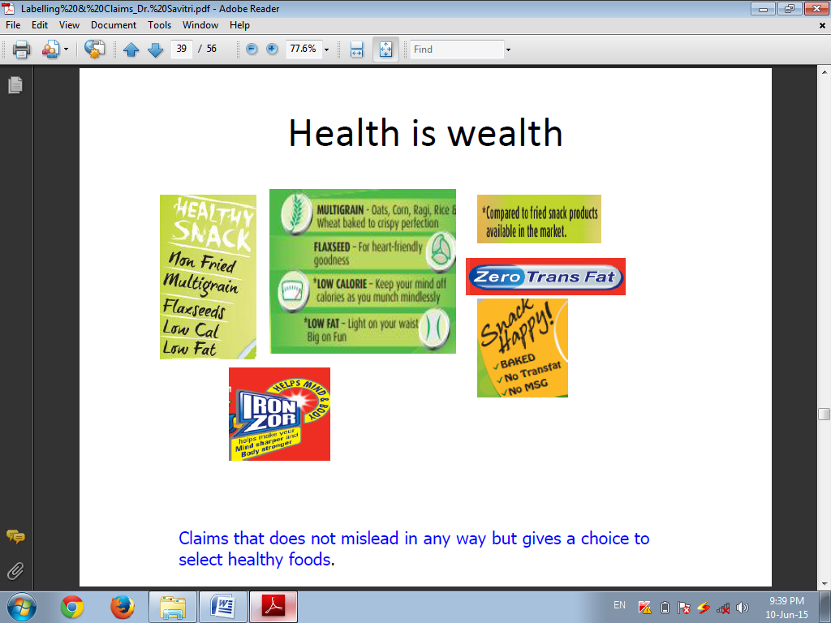
Nutrition/Functional claims
A nutrition claim describes what a food contains (or does not contain) or contains in reduced or increased amounts.
Examples include:
Low fat (less than 3g of fat per 100g food) Symbol
High fibre (more than 6g of fibre per 100g food) Symbol
Reduced sugar (30% less than the original product) Symbol
Zero transfat Symbol X
Food for thought: Nourishing mental well-being in vocational training
Erasmus+ 2025-1-ES01-KA210-VET-000358116

Slide 29
Expression of nutritional and health claims
Contains lycopene = nutritional claim if it is the name of the substance or a category of substances
Contains antioxidants = health claim because the name of the substance or category of substances also includes the indication of its functional role or a beneficial effect on health (contains probiotics/prebiotics)
Contains prebiotic fibers = health claim is also considered when the noun (fiber) is accompanied by an adjective referring to that substance (prebiotics)
Food for thought: Nourishing mental well-being in vocational training
Erasmus+ 2025-1-ES01-KA210-VET-000358116

Slide 30
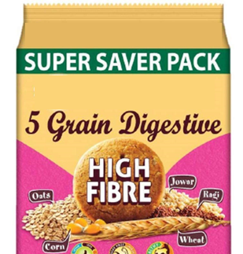
Expression of nutritional and health claims
All claims are subject to the general principles stipulated in art. 3 and 5 of the regulation:
- if the claim “contains” is used, this means that the respective substance is present in a sufficient quantity to ensure the claimed nutritional or physiological effect.
*more information available on: https://europa.eu/youreurope/business/product-requirements/food-labelling/nutrition-declaration/index_en.htm
Food for thought: Nourishing mental well-being in vocational training
Erasmus+ 2025-1-ES01-KA210-VET-000358116

Slide 31
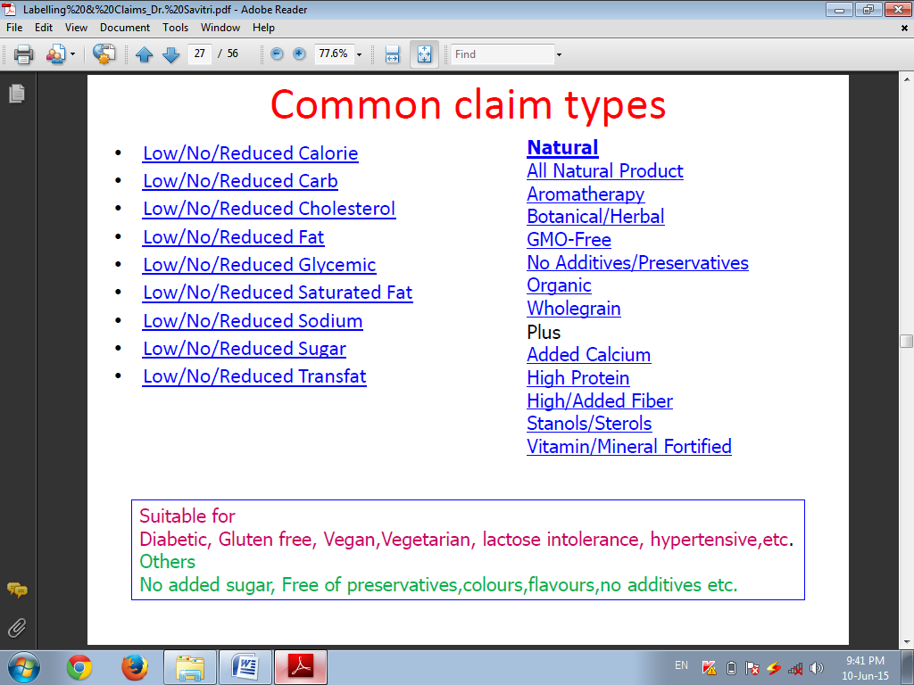
Food for thought: Nourishing mental well-being in vocational training
Erasmus+ 2025-1-ES01-KA210-VET-000358116

Slide 32
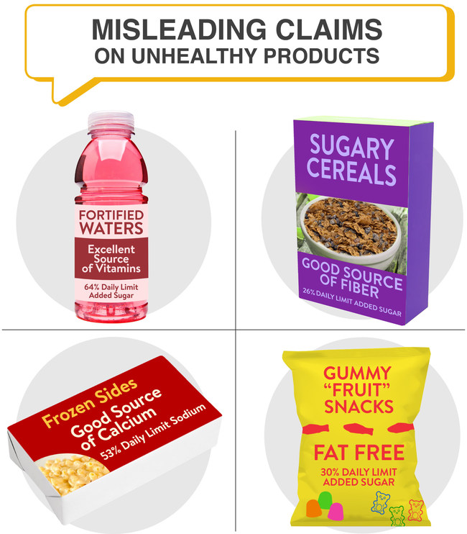
Food for thought: Nourishing mental well-being in vocational training
Erasmus+ 2025-1-ES01-KA210-VET-000358116

Slide 33
The use of nutritional and health claims in the promotion and advertising of food products
misleading advertising (claims without scientific justification; low levels of active ingredients, unable to support the body's functions;
hiding adverse effects; using the phrase "100% natural" even though they also contain synthetic substances)
comparative advertising (deceptive for the consumer, but also to the detriment of competitors on the same market)
use of claims not authorized at EU level intentional inducing of confusion (food products and functional role vs. therapeutic indications)
Directive 2006/114/EC (Law 158/2008, Audiovisual Code)
Food for thought: Nourishing mental well-being in vocational training
Erasmus+ 2025-1-ES01-KA210-VET-000358116

Slide 34
Comparative mentions allowed on the label
Examples:
Richer in: if the requirements for the use of the “source of” claim are met and if the “higher content” is 30% higher than in the similar product.
Low content of: if the reduction is at least 30% lower than in the similar product (except for micronutrients, where the difference is 10% and sodium, where it is 25%).
Provides less energy: 30% lower energy value + indications regarding the characteristics that determined the reduction of the total energy value of the product.
Light or lite: as for the claim “reduced content” or “free of” + indication of the reasons that led to the classification in the respective category (example: light - 50% sugars; light-no sugars).
Food for thought: Nourishing mental well-being in vocational training
Erasmus+ 2025-1-ES01-KA210-VET-000358116

Slide 35
Illegal additives
Chemicals that are not allowed but nevertheless present in food are not necessarily additives. Most man-made chemicals occur in nature in concentrations that can be detected now, but not some time ago. They are produced by:
  animals;
  microorganisms (bacteria, fungi);
  plants;
  geochemical processes (e.g. volcanos).
Food for thought: Nourishing mental well-being in vocational training
Erasmus+ 2025-1-ES01-KA210-VET-000358116

Slide 36
Allergen information
Any allergens present must be emphasised in the list of ingredients, for example by using a different font, letter size or background colour.
In the absence of a list of ingredients, the indication of allergens must include the word ‘contains' followed by the name of the allergen.
*see the complete list of allergens (https://eur-lex.europa.eu/legal-content/EN/TXT/HTML/?uri=CELEX:02011R1169-20180101#tocId71)
(source: https://europa.eu/youreurope/business/product-requirements/food-labelling/general-rules/index_en.htm)
Food for thought: Nourishing mental well-being in vocational training
Erasmus+ 2025-1-ES01-KA210-VET-000358116

Slide 37
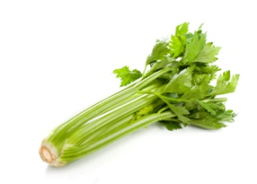
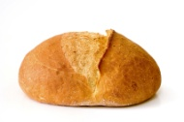
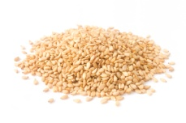
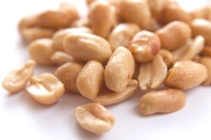
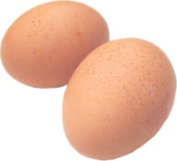
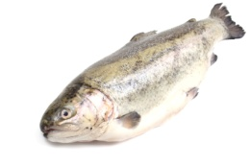

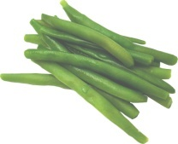
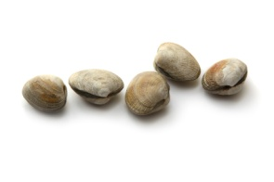
Allergy information
Within European Union, 14 foods are need to be mentioned on food label.
The 14 foods are:
celery;
cereals containing gluten (such as wheat, barley, rye and oats);
crustaceans (such as lobster and crab);
eggs;
fish;
lupins;
cow’s milk;
oysters;
mustard;
nuts (such as almonds, walnuts, brazil nuts, cashews);
peanuts;
sesame seeds;
soybeans;
sulphur dioxide and sulphites (preservatives used in some foods and drinks) at levels above 10 mg per kg or per litre.
Food for thought: Nourishing mental well-being in vocational training
Erasmus+ 2025-1-ES01-KA210-VET-000358116

Slide 38
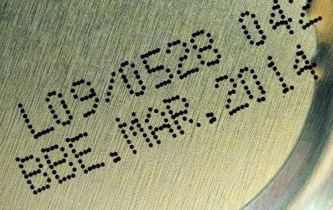
Date marks
There are two different date marks that appear on food labels
‘Use-by’ - found on perishable foods, e.g. milk, red meat, fish. Foods are not safe to eat after this date.
Best before’ - found on a wide range of food including fresh, frozen, dried, canned and other foods. Foods can be eaten after this date, but may not be at their best quality (quality, taste, texture and appearance).
Food for thought: Nourishing mental well-being in vocational training
Erasmus+ 2025-1-ES01-KA210-VET-000358116

Slide 39
Storage and preparation
In cases where foods require special storage conditions and/or conditions of use, these must be clearly indicated.
When necessary, instructions on how to prepare and cook the food must also be given on the label. If the food has to be heated, the temperature of the oven and the cooking time should be stated.
Instructions may also be given for heating in a microwave oven. These instructions should ensure the food tastes its best and that it will be thoroughly heated to a core temperature of 75°C, which minimizes the risk of food poisoning.
Food for thought: Nourishing mental well-being in vocational training
Erasmus+ 2025-1-ES01-KA210-VET-000358116

Slide 40
Name and address of the manufacturer, packer or seller
The name and address of the manufacturer, packer or seller must be stated on the label.
Consumers can then contact the manufacturer if they have a complaint about a product or if they wish to know more about it.
Food for thought: Nourishing mental well-being in vocational training
Erasmus+ 2025-1-ES01-KA210-VET-000358116

Slide 41
Country of origin and place of provenance
The European Union has created three systems to promote and protect regional food products. These include the Protected Designation of Origin (PDO), the Protected Geographical Indication (PGI), and the Traditional Specialty Guaranteed (TSG).
The European Union also permits the promotion of Quality Schemes. In Northern Ireland, Beef and Lamb is produced under the Northern Ireland Beef and Lamb Farm Quality Assurance Scheme (FQAS). This gives assurances about food safety, animal welfare and care for the environment.
Food for thought: Nourishing mental well-being in vocational training
Erasmus+ 2025-1-ES01-KA210-VET-000358116

Slide 42
Labeling as a form of food fraud
Many controversies:
How much consumers want to know about the food they buy;
The time consumers receive information at the time of purchase;
The space available to communicate the necessary information (Schiefer and Deiters, 2013).
The key elements that are present on labels – list of ingredients, nutritional information, suppliers, etc.
The messages that labels give to consumers
Food for thought: Nourishing mental well-being in vocational training
Erasmus+ 2025-1-ES01-KA210-VET-000358116

Slide 43
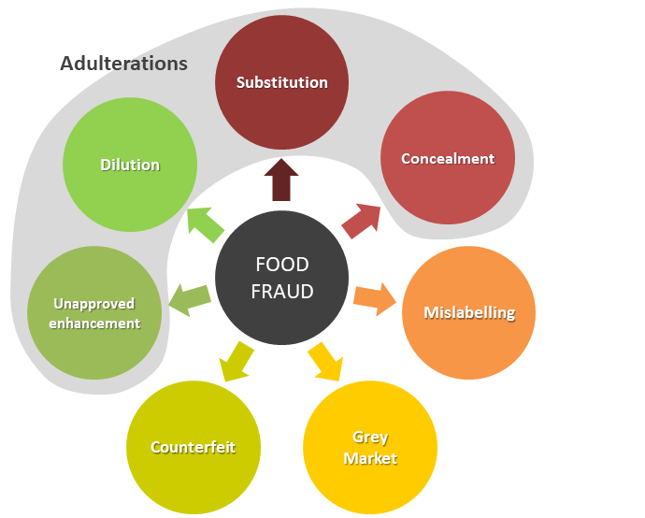
Food for thought: Nourishing mental well-being in vocational training
Erasmus+ 2025-1-ES01-KA210-VET-000358116

Slide 44
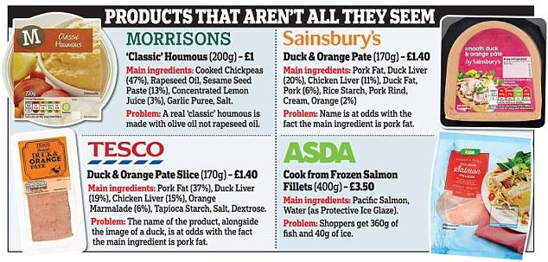
Labeling as a form of food fraud - Case studies
Food for thought: Nourishing mental well-being in vocational training
Erasmus+ 2025-1-ES01-KA210-VET-000358116

Slide 45
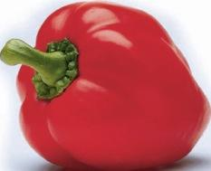
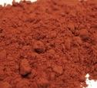
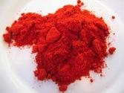
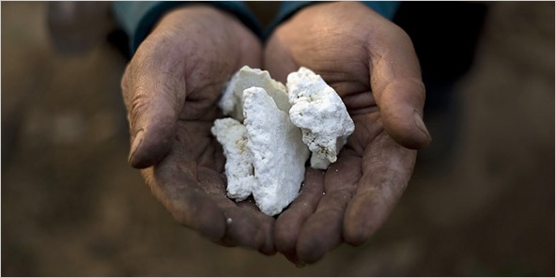


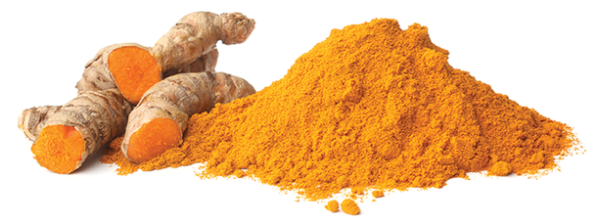
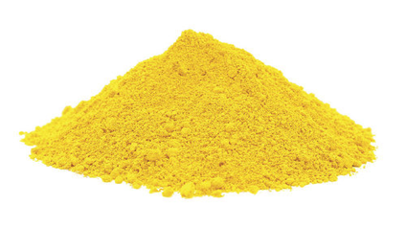
Examples of major food fraud that may lead to serious health effects … to make more profit
Lead oxide in paprika
Melamine in milk
and protein conc.
Lead chromate
in curcuma (turmeric)
Diethylene Glycol
Food for thought: Nourishing mental well-being in vocational training
Erasmus+ 2025-1-ES01-KA210-VET-000358116

Slide 46
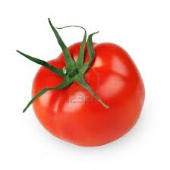
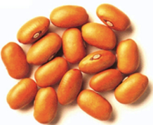
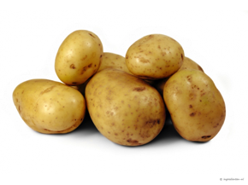
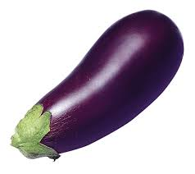
Natural, potentially toxic substances in food
lectins (or hemaglutinins) (pulses);
enzyme inhibitors (soy, peas, beet, cereals);
piperidines (black pepper);
caffein, theophilin (coffee, chocolade, tea);
solanine (potatoes, tomatoes, aubergines);
tomatine (tomatoes).
Food for thought: Nourishing mental well-being in vocational training
Erasmus+ 2025-1-ES01-KA210-VET-000358116

Slide 47
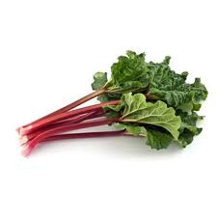

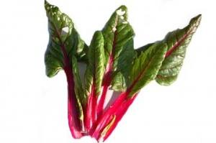

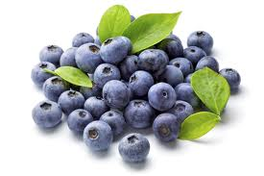
Natural, potentially toxic substances in food
oxalates (rhubarb, spinach, parsley, purslane, cassava, radish, kale);
coumarin (cinnamon, peppermint, green tea, chicory, blueberries).

Slide 48
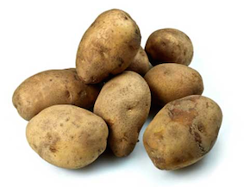
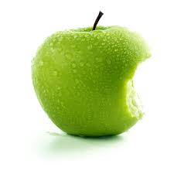
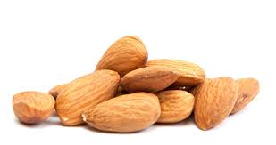

Natural, potentially toxic substances in food
cyanogenic glycosides, such as amygdalin (almond, laurel) and linamarin (cassave);
saponins (peanut, soy, spinach, broccoli, potato, apple);
growth hormones;
antibiotics.
Food for thought: Nourishing mental well-being in vocational training
Erasmus+ 2025-1-ES01-KA210-VET-000358116

Slide 49


Everything is poisonous if the amount is high enough
or
There are no toxic substances, only toxic concentrations
Food for thought: Nourishing mental well-being in vocational training
Erasmus+ 2025-1-ES01-KA210-VET-000358116

Slide 50

Many substances are harmless in the right amounts but harmful if
too much or not enough.
Food for thought: Nourishing mental well-being in vocational training
Erasmus+ 2025-1-ES01-KA210-VET-000358116

Slide 51


Vitamin A
Adults: needed 1 mg per day harmful at 3 mg per day.
Authorised vitamins and minerals amounts must be expressed:
per 100 g or per 100 ml
as a percentage of reference intakes
Seleen
Adults: needed 50-150 μg per day harmful at 300 μg per day.
(Netherlands Health Council)
* Vitamins and minerals authorised in the nutrition declaration are listed on the following link: https://eur-lex.europa.eu/legal-content/EN/TXT/?uri=CELEX:32011R1169#d1e32-61-1
(source: https://europa.eu/youreurope/business/product-requirements/food-labelling/nutrition-declaration/index_en.htm)
Food for thought: Nourishing mental well-being in vocational training
Erasmus+ 2025-1-ES01-KA210-VET-000358116

Slide 52

Evolution
Humans and their predecessors have been exposed to all those most scary chemicals for millions of years and developed a biological system (with liver, kidneys, etc.) to cope with them or even use them beneficially.
The system, however, can be overloaded and then the chemical becomes toxic.
Food for thought: Nourishing mental well-being in vocational training
Erasmus+ 2025-1-ES01-KA210-VET-000358116

Slide 53

Food for thought: Nourishing mental well-being in vocational training
Erasmus+ 2025-1-ES01-KA210-VET-000358116

Slide 54

What would you do …?
Food for thought: Nourishing mental well-being in vocational training
Erasmus+ 2025-1-ES01-KA210-VET-000358116

Slide 55

Check the Label Information
Understand The Basics of the Food Label;
Look at the list of ingredients;
This gives an overview of the product’s "recipe". Ingredients are arranged from the most to the least amount. If a product lists its ingredients as:
Sugar, Water, Juice Concentrate,
Artificial Flavor
This means that the bulk of the product is sugar.
The ingredient with least amount is juice concentrate.
Food for thought: Nourishing mental well-being in vocational training
Erasmus+ 2025-1-ES01-KA210-VET-000358116

Slide 56

Watch the nutrient amounts
Read the Nutrition Information Label for nutrient amounts.
These are given either by per 100g of the product or the Recommended energy and Nutrient Intake (%RDA, which is based on ICMR nutrient recommendation).
This allows you to compare nutrient amounts among different brands of a particular food.
Food for thought: Nourishing mental well-being in vocational training
Erasmus+ 2025-1-ES01-KA210-VET-000358116

Slide 57
Get more value
There are 2 items you'll need to look at:
Net Weight is the amount of product inside the pack: This can be found near the bottom of a pack, usually at the front of the packaging.
Serving Size: is the amount (usually in grams or millilitres) per serving of a product
Divide Net Weight by Serving Size. This gives you the number of servings in the pack.
Food for thought: Nourishing mental well-being in vocational training
Erasmus+ 2025-1-ES01-KA210-VET-000358116

Slide 58




Understand nutrient content claims.
They are not always as they seem!
A zero-calorie product can actually contain up to 4 calories per serving;
A fat-free product can contain up to 0.5 grams of fat per serving;
A low-fat product can have as much as 3 grams for solid products and 1.5g for liquid products.
Food for thought: Nourishing mental well-being in vocational training
Erasmus+ 2025-1-ES01-KA210-VET-000358116

Slide 59


Here are some pointers to help you read and interpret the information on food labels.
5g fat is equal to one teaspoon of fat (picture a teaspoon of butter). If a food says it has 30g fat per serve, that’s equivalent to eating about six teaspoons of butter!
5g sugar is equal to one teaspoon
of sugar.
If a can of soft drink has 40g sugar –
that’s like eating eight teaspoons of sugar.
Food for thought: Nourishing mental well-being in vocational training
Erasmus+ 2025-1-ES01-KA210-VET-000358116

Slide 60


Foods with 3 g of dietary fibre means that they are a source of dietary fibre and that with 6 g per 100 g means that they are high in fibre.
Don’t assume that all foods displaying the word ‘light’ are low in fat or kilojoules/calories. The term ‘Light’ or ‘Lite’ on a food label may also mean the food is light in fat, light in salt, light in colour, or even light in taste. The characteristic which makes the food ‘light’ must be stated on the label, so take a closer look to see what it really mean.
Food for thought: Nourishing mental well-being in vocational training
Erasmus+ 2025-1-ES01-KA210-VET-000358116

Slide 61
Nutrition Claims
When you want to decrease the amount of certain nutrients, look for:
Free | none or hardly any of this nutrient an example is “sodium free”
Low | a small amount an example is “low fat”
Reduced | at least 25% less of the nutrient compared with a similar product an example is “reduced in Calories”
Light | can be used on foods that are reduced in fat or reduced in Calories
Food for thought: Nourishing mental well-being in vocational training
Erasmus+ 2025-1-ES01-KA210-VET-000358116

Slide 62
Nutrition Claims
When you want to increase the amount of certain nutrients, look for:
Source | contains a significant amount of the nutrient an example is “source of fibre”
High or good source | contains a high amount of the nutrient an example is “high in vitamin C”
Very high or excellent source | contains a very high amount of the nutrient an example is “excellent source of calcium”
Food for thought: Nourishing mental well-being in vocational training
Erasmus+ 2025-1-ES01-KA210-VET-000358116

Slide 63
Conclusions
Nutritional Labeling is beneficial to food producer to attract
consumers towards their products w.r.t. its nutritional content.
The nutrition information on food labels helps consumers to
compare products more easily, determine the nutritional value
of foods and better manage special diets.
Shopping Tips for consumers
Read the ingredients what you’re really getting
Watch for sugar content and calories
Look at the serving size and servings per container
Look at nutrients to limit (fat, cholesterol)
Food for thought: Nourishing mental well-being in vocational training
Erasmus+ 2025-1-ES01-KA210-VET-000358116

Slide 64


Nutritional Label Analysis
- Case studies on Romanian local food products -
THE ROLE OF THE LABEL
?
👉 It allows us to consciously choose what we consume.
👉 It gives us the opportunity to make informed choices about the foods we buy.
Food for thought: Nourishing mental well-being in vocational training
Erasmus+ 2025-1-ES01-KA210-VET-000358116

Slide 65


Food for thought: Nourishing mental well-being in vocational training
Erasmus+ 2025-1-ES01-KA210-VET-000358116

Slide 66




Food for thought: Nourishing mental well-being in vocational training
Erasmus+ 2025-1-ES01-KA210-VET-000358116

Slide 67


Food for thought: Nourishing mental well-being in vocational training
Erasmus+ 2025-1-ES01-KA210-VET-000358116

Slide 68




Food for thought: Nourishing mental well-being in vocational training
Erasmus+ 2025-1-ES01-KA210-VET-000358116

Slide 69




Food for thought: Nourishing mental well-being in vocational training
Erasmus+ 2025-1-ES01-KA210-VET-000358116

Slide 70


Food for thought: Nourishing mental well-being in vocational training
Erasmus+ 2025-1-ES01-KA210-VET-000358116

Slide 71


Food for thought: Nourishing mental well-being in vocational training
Erasmus+ 2025-1-ES01-KA210-VET-000358116

Slide 72




Food for thought: Nourishing mental well-being in vocational training
Erasmus+ 2025-1-ES01-KA210-VET-000358116

Slide 73


Food for thought: Nourishing mental well-being in vocational training
Erasmus+ 2025-1-ES01-KA210-VET-000358116

Slide 74




Food for thought: Nourishing mental well-being in vocational training
Erasmus+ 2025-1-ES01-KA210-VET-000358116

Slide 75



Food for thought: Nourishing mental well-being in vocational training
Erasmus+ 2025-1-ES01-KA210-VET-000358116

Slide 76
Nutrition Labelling Summary
Use Nutrition Facts, the ingredient list, nutrition claims and health claims to make informed food choices.
Nutrition Facts are based on a specific amount of food - compare this to the amount you eat.
Use the % Daily Value to see if a food has a little or a lot of a nutrient. Remember:
  5% DV or less is a little, 15 % DV or more is a lot.
Food for thought: Nourishing mental well-being in vocational training
Erasmus+ 2025-1-ES01-KA210-VET-000358116

Slide 77



Use nutrition information on food labels to help you make better food choices!
Be curious, be attentive, be smart — read the label!
More information available on: https://food.ec.europa.eu/food-safety/labelling-and-nutrition_en
Food for thought: Nourishing mental well-being in vocational training
Erasmus+ 2025-1-ES01-KA210-VET-000358116

Slide 78

Food for thought: Nourishing mental well-being in vocational training
Erasmus+ 2025-1-ES01-KA210-VET-000358116

