Slide 1

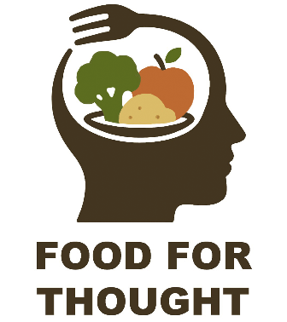

“This project has been funded with support from the European Commission. This communication reflects the views only of the author, and the European Commission and Spanish National Agency cannot be held responsi­ble for any use which may be made of the information contained therein”
Healthy Choices, Healthy Lives: Nutrition Insights for Young Adults
Food for thought: Nourishing mental well-being in vocational training
Erasmus+ 2025-1-ES01-KA210-VET-000358116

Slide 2
Introduction
Nutrition is the study of nutrients in food, how the body uses them, and the relationship between diet, health, and disease.
Nutritionists use ideas from molecular biology, biochemistry, and genetics to understand how nutrients affect the human body.
Nutrition also focuses on how people can use dietary choices to reduce the risk of disease, what happens if a person has too much or too little of a nutrient, and how allergies work.
Nutrients provide nourishment. Proteins, carbohydrates, fat, vitamins, minerals, fiber, and water are all nutrients. If people do not have the right balance of nutrients in their diet, their risk of developing certain health conditions increases.
Food for thought: Nourishing mental well-being in vocational training
Erasmus+ 2025-1-ES01-KA210-VET-000358116

Slide 3
What is Nutrition?
Nutrition is the science that interprets the nutrients and other substances in food in relation to maintenance, growth, reproduction, health and disease of an organism. It includes food intake, absorption, assimilation, biosynthesis, catabolism and excretion.
Nutrition: the study of food, including
  How food nourishes our bodies
  How food influences our health
Nutrition is a relatively new discipline of science.
Goals of Healthy People:
  Increase quality and years of healthy life
  Eliminate health disparities
Food for thought: Nourishing mental well-being in vocational training
Erasmus+ 2025-1-ES01-KA210-VET-000358116

Slide 4
Aims of Nutrition
To educate people about good nutrition so that they can have complete physical and mental development.
To educate about the cheap and easily available food sources so that every body can get adequate nutrition.
Food described dependences of other related factors on nutrition like food related habits, care of food, personal hygiene and sanitation so that people can get proper nutrition.
Food for thought: Nourishing mental well-being in vocational training
Erasmus+ 2025-1-ES01-KA210-VET-000358116

Slide 5
Importance
Nutrition contributes to wellness.
Wellness: the absence of disease
  Physical, emotional, and spiritual health
Critical components of wellness:
  Nutrition
  Physical activity
Restaurant and foodservice professionals need to understand the nutritional needs of their customers.
When restaurant and foodservice professionals understand how to combine nutrition science and culinary arts, they are able to provide food that is both delicious and healthful.
Food for thought: Nourishing mental well-being in vocational training
Erasmus+ 2025-1-ES01-KA210-VET-000358116

Slide 6
Nutrition can prevent disease.
    Nutrient deficiency diseases
      Scurvy
        Vitamin C deficiency which causes general weakness, anemia, gum disease, and skin hemorrhages.
      Goiter
        Iodine deficiency which causes an enlargement of the thyroid gland
      Rickets
        Deficiencies of vitamin D, calcium, or phosphate which leads to softening & weakening of the bones
    Diseases influenced by nutrition:
    chronic diseases such as heart disease
    Diseases in which nutrition plays a role:
    osteoarthritis, osteoporosis
    Diseases influenced by nutrition:
    chronic diseases such as heart disease
    Diseases in which nutrition plays a role
      Osteoporosis
        Weakening of the bones
        Can be caused by long-term deficiencies of calcium, magnesium and vitamin D
Food for thought: Nourishing mental well-being in vocational training
Erasmus+ 2025-1-ES01-KA210-VET-000358116

Slide 7
Basic Nutritional Principles (I)
Balance calories to manage weight
  Calorie intake in relationship to level of physical activity during each life stage.
Reduce certain foods & food components
  Sodium intake to less than 2300mg daily;
  Consume <10% of calories from saturated fats;
  Limit foods that contain refined grains;
  Reduce calories from solid fats & sugars;
  If consumed, alcohol should be used in moderation.
People need certain nutrients on a regular basis to maintain health and prevent disease.
Food for thought: Nourishing mental well-being in vocational training
Erasmus+ 2025-1-ES01-KA210-VET-000358116

Slide 8
Basic Nutritional Principles (II)
Increase certain foods & nutrients
  Increase fruit & vegetable intake
    Focus on dark green & orange vegetables, beans & peas;
    One-half grains as whole grains;
    Increase intake of fat-free or low-fat milk/milk products;
    Choose a variety of proteins, including seafood, lean meat, poultry, eggs, beans and unsalted nuts & seeds;
    Use oils to replace solid fats;
    Choose foods higher in potassium, fiber, calcium, vit. D;
Build healthy eating patterns
  Eat in a way that meets nutritional needs & appropriate calories.
Food for thought: Nourishing mental well-being in vocational training
Erasmus+ 2025-1-ES01-KA210-VET-000358116

Slide 9
Basic Nutritional Principles (III)
Learn to read food labels;
  Determine serving size;
  Determine servings per container;
  Evaluate number of calories per serving;
  Calculate fat;
  Determine Recommended Dietary Allowances (RDA);
    The average daily intake level required to meet the needs of 97 – 98% of people for a specific nutrient.
Food for thought: Nourishing mental well-being in vocational training
Erasmus+ 2025-1-ES01-KA210-VET-000358116

Slide 10
Energy From Nutrients
The human body needs calories to survive. Without energy, the cells in the body would die, the heart and lungs would stop, and the organs would not be able to carry out the basic processes needed for living. People absorb this energy from food and drink.
If people consumed only the number of calories needed every day, they would probably have healthy lives. Calorie consumption that is too low or too high will eventually lead to health problems.
There are two types of calorie:
A small calorie (cal) is the amount of energy required to raise the temperature of 1 gram (g) of water by 1ºC.
A large calorie (kcal) is the amount of energy required to raise 1 kilogram of water by 1º C. It is also known as a kilocalorie.
Food for thought: Nourishing mental well-being in vocational training
Erasmus+ 2025-1-ES01-KA210-VET-000358116

Slide 11
Energy Needs of the Body
Calculated by sum of 3 factors:
Basal metabolism.
Energy for physical activity.
Small amount of additional energy expended during digestion and absorption of carbohydrates, proteins fats in gastrointestinal tract (GIT) – specific dynamic action (SDA) of food.
Energy requirement= BM + Physical Activity + SDA
Food for thought: Nourishing mental well-being in vocational training
Erasmus+ 2025-1-ES01-KA210-VET-000358116

Slide 12
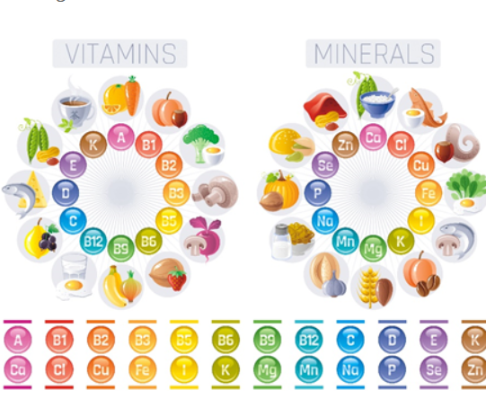
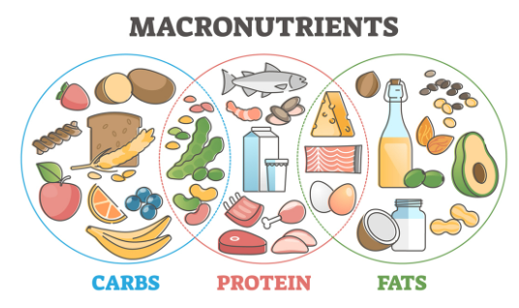
The Six Nutrients For Health
Carbohydrates
Proteins
Fats
Fibers
Vitamins
Water
Food for thought: Nourishing mental well-being in vocational training
Erasmus+ 2025-1-ES01-KA210-VET-000358116

Slide 13
BASIC 4 FOOD GROUPS
A healthful, balanced diet includes foods from these four groups:
Green leafy vegetables and fruits group
Cereal group ; Bread, rice, wheat, barley
Meat group ; Meat, fish, egg, pulses, nuts, etc
Milk group ; All dairy products
CARBOHYDRATES
50-60%
PROTEINS
20-30%
FATS
10-15%
Food for thought: Nourishing mental well-being in vocational training
Erasmus+ 2025-1-ES01-KA210-VET-000358116

Slide 14
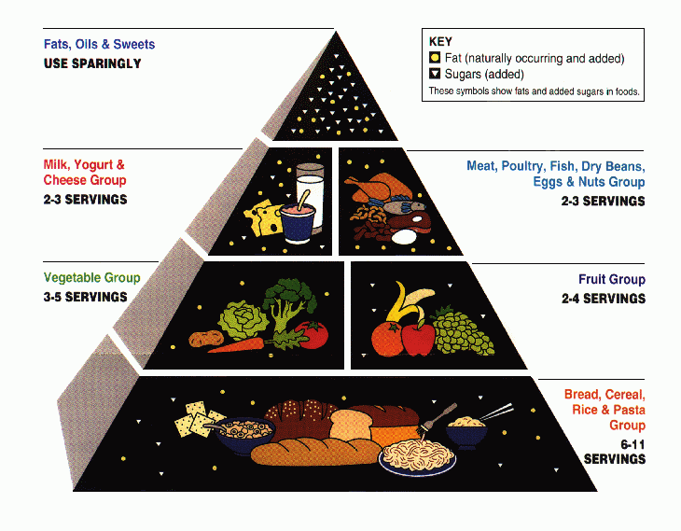
The nutrition pyramid
Food for thought: Nourishing mental well-being in vocational training
Erasmus+ 2025-1-ES01-KA210-VET-000358116

Slide 15
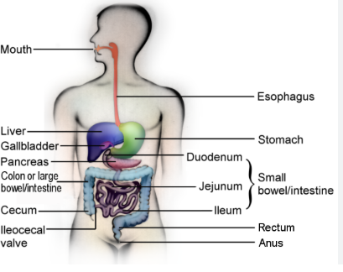
Utilization of Nutrients
The body prepares the nutrients for use through the following processes:
  Digestion
  Absorption
  Metabolism
Food for thought: Nourishing mental well-being in vocational training
Erasmus+ 2025-1-ES01-KA210-VET-000358116

Slide 16
1. Digestion
The process in which the body breaks down food into smaller parts
  Mechanical
    Food in broken down by the teeth
    Moved through the system using peristalsis
  Chemical
    Food mixed with digestive juices secreted by
      Mouth
      Stomach
      Small intestine
      Pancreas
    Juices contain enzymes designed to break down the food chemically so nutrients can be absorbed by the blood
Food for thought: Nourishing mental well-being in vocational training
Erasmus+ 2025-1-ES01-KA210-VET-000358116

Slide 17
2. Absorption
The process in which blood or lymph capillaries pick up the digested materials
  Most absorption happens in the small intestine
    Exception is water, salts & some vitamins
    (large intestine)
Carries nutrients through the circulatory system to every cell in the body
Food for thought: Nourishing mental well-being in vocational training
Erasmus+ 2025-1-ES01-KA210-VET-000358116

Slide 18
Metabolism
The process in which nutrients are used
  To build tissue
  To provide energy
    Voluntary
      Swimming, housekeeping
    Involuntary
      Breathing, circulation, digestion
  To regulate various body functions
Basal Metabolic Rate (BMR)
  The rate at which the body uses energy just to maintain it own tissue (involuntary)
Food for thought: Nourishing mental well-being in vocational training
Erasmus+ 2025-1-ES01-KA210-VET-000358116

Slide 19
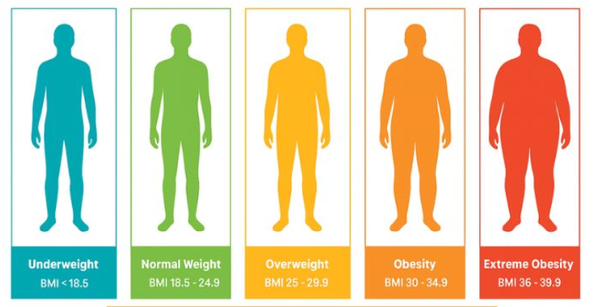
Body Mass Index (BMI)
A calculation that measures weight in relation to height and correlates this with body fat:
  Ideal range is 18.5 – 24.9;
  <18.5 = underweight;
  25 – 29.9 overweight;
  >30 obese.
Food for thought: Nourishing mental well-being in vocational training
Erasmus+ 2025-1-ES01-KA210-VET-000358116

Slide 20
WEIGHT CONTROL
The Human body has always been admired for it symmetry and beauty. But the image of the ideal physique has varied throughout history and culture. Good nutrition and a fitness program are the keys to a healthful, more attractive self-image..
OBESITY
- being overweight, over fat (obese)
- the more obese a person, is the more common
health problems related to obesity become.
- it increases the risk of both heart disease and
stroke.
- it increases the risk of diabetes, kidney, gallbladder,
joint diseases, and posture problem.
WHAT CAUSES OBESITY?
Simply stated, obesity result when the intake of calories exceeds caloric expenditure.
- diet
- physical activity
- environmental exposures
- genetic background
Food for thought: Nourishing mental well-being in vocational training
Erasmus+ 2025-1-ES01-KA210-VET-000358116

Slide 21
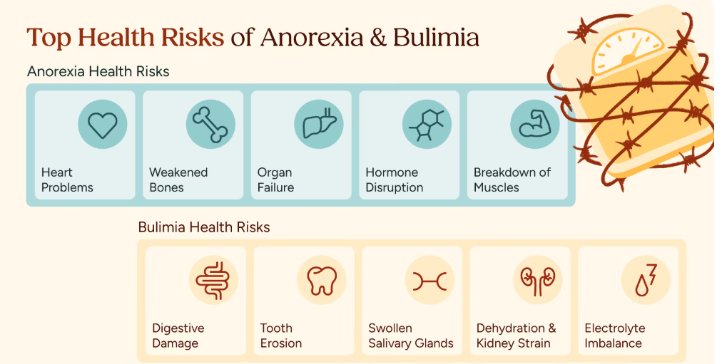
Anorexia
An eating disorder characterized by extreme weight loss, poor body image, and irrational fears of weight gain and obesity.
Starves the body, muscle tissues waste away. The skin dries and yellow and the hair thins and falls out . Blood pressure drops. Menstruation ceases, and weight drops drastically.
Bulimia
An eating disorder characterized by recurrent episode of rapid uncontrolled eating of large amounts of food in a short period of time. Episode of binge eating are often followed by purging.
Food for thought: Nourishing mental well-being in vocational training
Erasmus+ 2025-1-ES01-KA210-VET-000358116

Slide 22
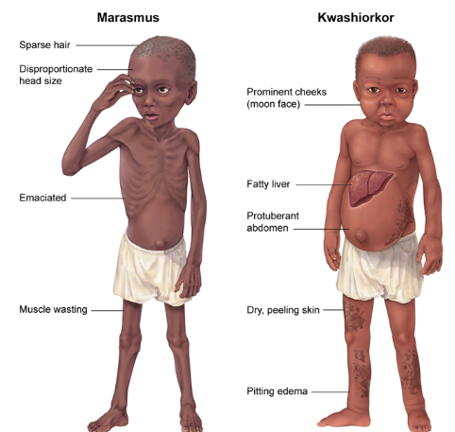
Marasmus
- malnutrition caused by a lack of calories and protein
- children with marasmus look like “skin and bones”, they don’t get enough calories and protein in their diet.
Kwashiorkor
- malnutrition resulting from inadequate protein intake in children.
- this children has the characteristic of “moon face”(edema), swollen belly, and patchy dermatitis.
- they not look starved because of the massive swelling.
Food for thought: Nourishing mental well-being in vocational training
Erasmus+ 2025-1-ES01-KA210-VET-000358116

Slide 23
Malnutrition
Malnutrition is a condition that results from eating a diet in which one or more nutrients are either not enough or are too much such that the diet causes health problems. It may involve calories, protein, carbohydrates, vitamins or minerals.
Malnutrition refers to deficiencies, excesses or imbalances in a person’s intake of energy and/or nutrients.
The term malnutrition covers 2 broad groups of conditions. One is ‘undernutrition, and the other is overnutrition that causes obesity and diet-related noncommunicable diseases (such as heart disease, stroke, diabetes and cancer).
(According to WHO)
Food for thought: Nourishing mental well-being in vocational training
Erasmus+ 2025-1-ES01-KA210-VET-000358116

Slide 24
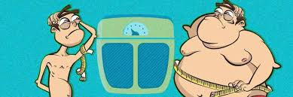
Undernutrition denotes insufficient intake of energy and nutrients to meet an individual's needs to maintain good health.
Overnutrition is a form of malnutrition in which the intake of nutrients is oversupplied. The amount of nutrients exceeds the amount required for normal growth, development, and metabolism.
Food for thought: Nourishing mental well-being in vocational training
Erasmus+ 2025-1-ES01-KA210-VET-000358116

Slide 25
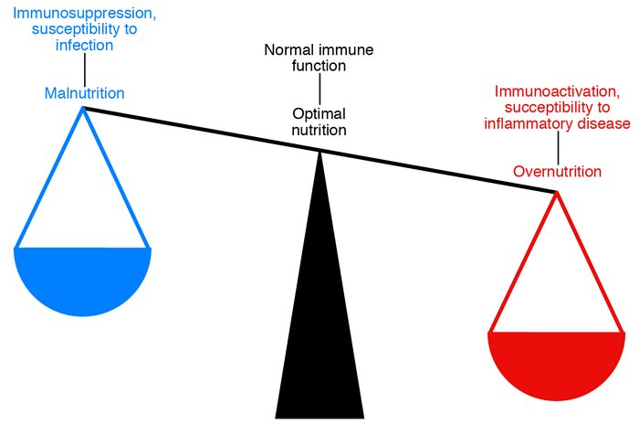
Optimum Nutrition
The term "Optimum Nutrition" can be defined as eating the right amounts of nutrients on a proper schedule to achieve the best performance & the longest possible lifetime in good health, assuming that external negative influences like accidents & infectious diseases can be avoided.
Food for thought: Nourishing mental well-being in vocational training
Erasmus+ 2025-1-ES01-KA210-VET-000358116

Slide 26
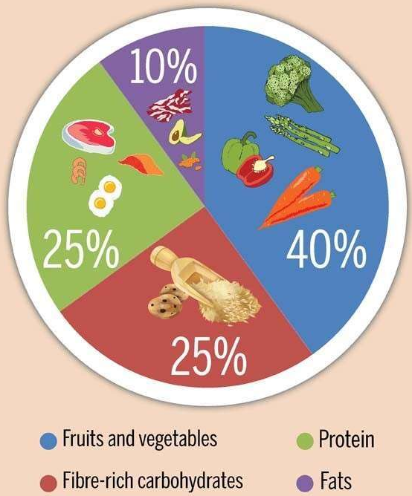
Balanced diet
A balanced diet means “getting the right types and amounts of foods and drinks to supply nutrition and energy for maintaining body cells, tissues, and organs, and for supporting normal growth and development”.
It is the diet that contain a variety of foods which fulfills the need for energy , amino acids , vitamins , minerals and other nutrients necessary for maintaining health, provides extra nutrients to withstand short duration of illness.
Food for thought: Nourishing mental well-being in vocational training
Erasmus+ 2025-1-ES01-KA210-VET-000358116

Slide 27
Importance of a Balanced Diet
The following are the importance of a balanced diet :
Leads to a good physical and a good mental health.
Helps in proper growth of the body.
Increases the capacity to work.
Increases the ability to fight or resist diseases.
Disease prevention.
Eating a balance diet is the easiest way to protect yourself from many of the diseases associated with ageing, including diabetes and heart disease.
Food for thought: Nourishing mental well-being in vocational training
Erasmus+ 2025-1-ES01-KA210-VET-000358116

Slide 28
Components of a balanced diet
Some components of a balanced diet are as follows :
Fats: Some part of our energy requirement is fulfilled by fats. Fats can be found in fatty foods such as butter, ghee, oil, cheese, etc.
Proteins: We need proteins for growth purposes and to repair the wear and tear of the body. Protein also helps in building muscle. It is found in dairy products, sprouts, meat, eggs, chicken, etc
Carbohydrates: We need the energy to process and it is fulfilled by carbohydrates. Carbs provide us energy. Carbohydrates can be found in rice, wheat, chapati, bread, etc. Cereals are our staple food.
Minerals and Vitamins: Vitamins, Minerals, and Fibre improve the body’s resistance to disease. We mainly obtain it from vegetables and fruits. Deficiency diseases like Anemia, Goitre, etc can be caused due to lack of mineral in the body.
Food for thought: Nourishing mental well-being in vocational training
Erasmus+ 2025-1-ES01-KA210-VET-000358116

Slide 29
Water - component of a balanced diet
Water is an essential nutrient. It is essential to all forms of life.
About 55 to 65 percent of the human body is water by weight. Cells, tissues, and organs need water to function.
Water has many important roles:
  Helping with the digestion, absorption, and transportation of nutrients.
  Helping with the elimination of wastes through the kidneys, colon, and lungs.
  Distributing heat throughout the body and allowing heat to be released through the skin by evaporation (sweating).
  Lubricating joints and cushioning body tissues.
The human body can live a long time without many other nutrients, but only a few days without water.
Your body loses water by perspiration. When you exhale, you lose water as water vapor. Then, your nervous system send a signal to your brain for water. This is why you feel thirsty.
Food for thought: Nourishing mental well-being in vocational training
Erasmus+ 2025-1-ES01-KA210-VET-000358116

Slide 30
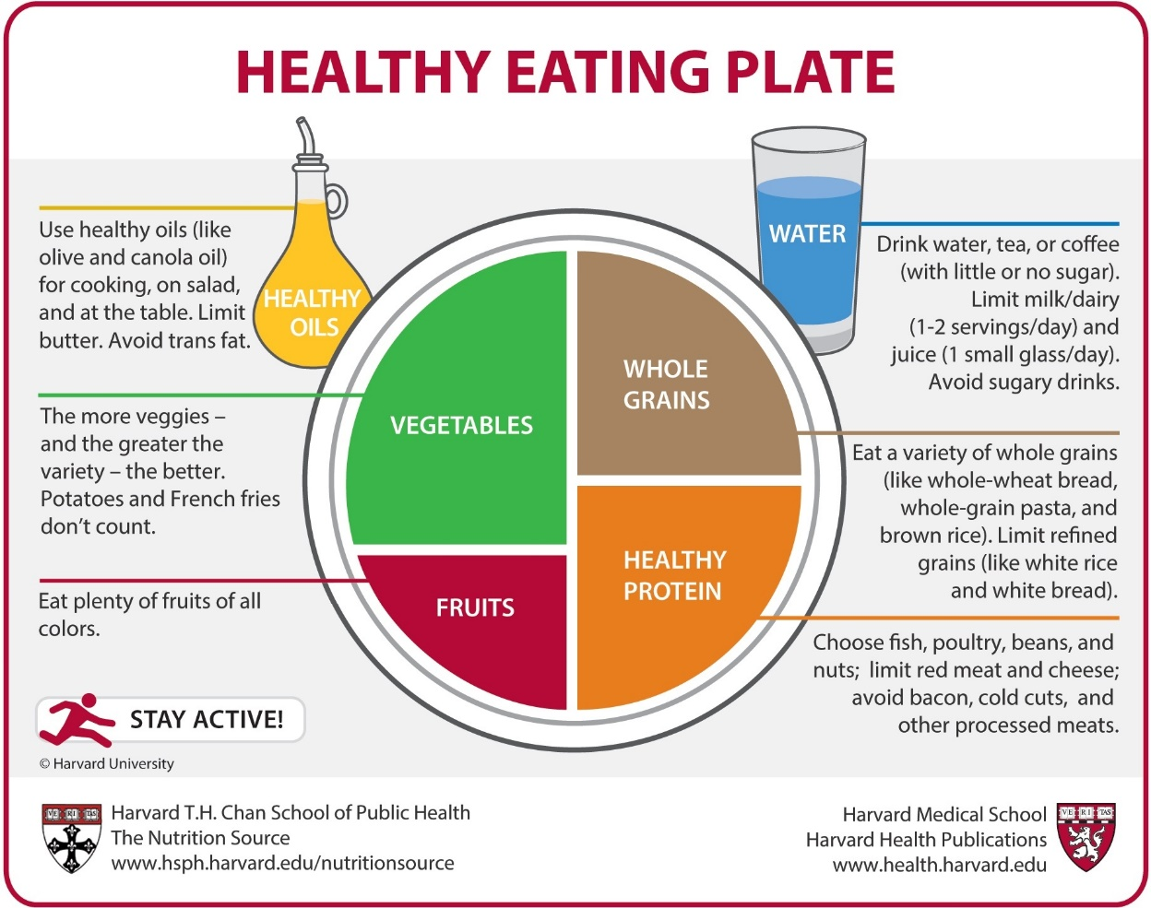
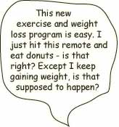
Proper Diet
Along with exercise, a proper diet is essential for weight control and physical fitness.
How you eat has a huge impact on your physique and how your body metabolizes food.
Food for thought: Nourishing mental well-being in vocational training
Erasmus+ 2025-1-ES01-KA210-VET-000358116

Slide 31
WHY DO WE NEED A BALANCED DIET?
A balanced diet is one that fulfills all of a person’s nutritional needs. Humans need a certain amount of calories and nutrients to stay healthy.
A balanced diet provides all the nutrients a person requires, without going over the recommended daily calorie intake.
By eating a balanced diet, people can get the nutrients and calories they need and avoid eating junk food, or food without nutritional value.
Food for thought: Nourishing mental well-being in vocational training
Erasmus+ 2025-1-ES01-KA210-VET-000358116

Slide 32
HOW TO PLAN A BALANCED DIET?
Age, sex and caloric requirement.
Selection of nutrients from basic food groups.
Economic status from Basic Food Groups.
High-cost and low-cost diet.
Take into account:
Kinds of food produced in the region;
Economic capacity;
Religion of the person;
Habit and interest of the people;
Customs;
Tastes.
Food for thought: Nourishing mental well-being in vocational training
Erasmus+ 2025-1-ES01-KA210-VET-000358116

Slide 33


Tips about Nutrition
If you don't use a proper diet, little things might happen like:
Maybe you’re too tired to do your work at school, or it takes longer to get over a cold, cuts and injuries might take longer to heal, you're cranky.
Food for thought: Nourishing mental well-being in vocational training
Erasmus+ 2025-1-ES01-KA210-VET-000358116

Slide 34
DIETARY GUIDELINES
EAT VARIETY OF FOODS. - Include the selections of fruits, vegetables, milk cheese, yogurt, meats, poultry, fish, eggs, and legumes. Whole grain, cereals. 2. MAINTAIN IDEAL WEIGHT. - to improve eating habits: eat slowly, prepare smaller portion; avoid seconds - to loose weight; increase physical activity, eat less fat and fewer fatty foods, eat less sugar, avoid too much alcohol. 3. AVOID TOO MUCH FAT,SATURATED FAT AND CHOLESTEROL. - choose lean meat, fish, poultry, dry bean as your protein sources. - moderate your use of eggs, and organ meats (such as liver) - limit your intake of butter, cream, margarine, coconut oil and food made from such products. 4. EAT FOOD WITH ADEQUATE STARCH AND FIBERS. -substitute starches for fat and sugar, select foods that are good sources of fiber and starch, such as whole-grain bread and cereals, fruits and vegetables. 5. AVOID TOO MUCH SUGAR. - use less of all sugars such as brown ,white sugar, raw sugar, honey, syrups - eat fewer foods containing these sugars. 6. AVOID TOO MUCH SODIUM 7. IF YOU DRINK ALCOHOL,DO SO IN MODERATION .
Food for thought: Nourishing mental well-being in vocational training
Erasmus+ 2025-1-ES01-KA210-VET-000358116

Slide 35

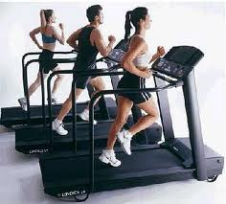
Exercise IS important
Physical activity is associated with neurochemical changes, including alterations in cortisol levels and increased production of endorphins, endocannabinoids, serotonin, and dopamine.
Also causes positive changes in microbiome bacterial diversity.
Exercise also improves blood flow to brain and stimulates brain cell regeneration via BDNF.
Socialising while exercise gives an additional mood boost.
And fun!
So go outside and play!!
Food for thought: Nourishing mental well-being in vocational training
Erasmus+ 2025-1-ES01-KA210-VET-000358116

Slide 36
Microflora management for improved gut health
The human gut is dominated by several bacterial phyla including Bacteroidetes, Firmicutes, and Actinobacteria.
The term “microbiota,” “microflora,” or “normal flora” is used to designate this vast host of microbes which coexist with the host
It is estimated that the human microbiota contains as many as 10¹⁴ bacterial cells, a number that is 10 times greater than the number of human cells present in our bodies.
Virtually every surface of the human body starting from the skin surface to the genitourinary tract, oral cavity, respiratory tract, ear, and the gastrointestinal (GI) tract is colonized heavily by various species of bacteria.
By far, the most heavily colonized organ is the gastrointestinal tract which houses a huge microbial ecosystem; the colon alone is estimated to contain over 70% of all the microbes in the human body.
Food for thought: Nourishing mental well-being in vocational training
Erasmus+ 2025-1-ES01-KA210-VET-000358116

Slide 37
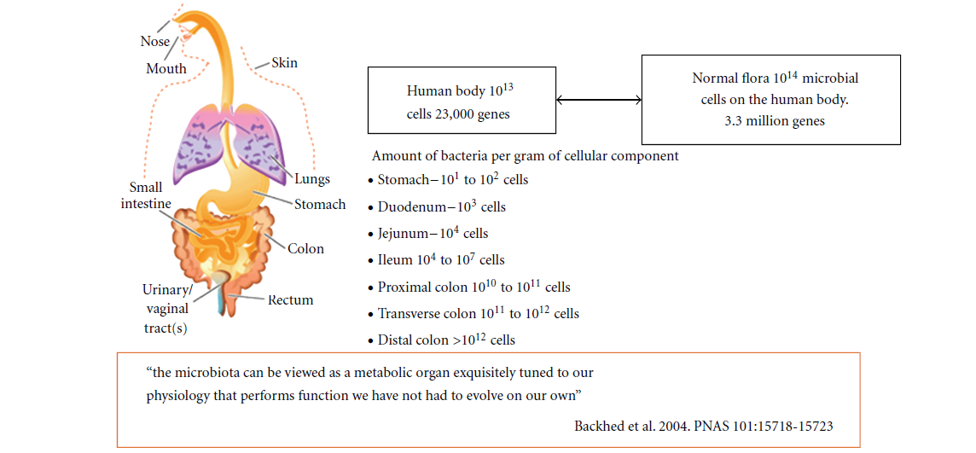
Food for thought: Nourishing mental well-being in vocational training
Erasmus+ 2025-1-ES01-KA210-VET-000358116

Slide 38
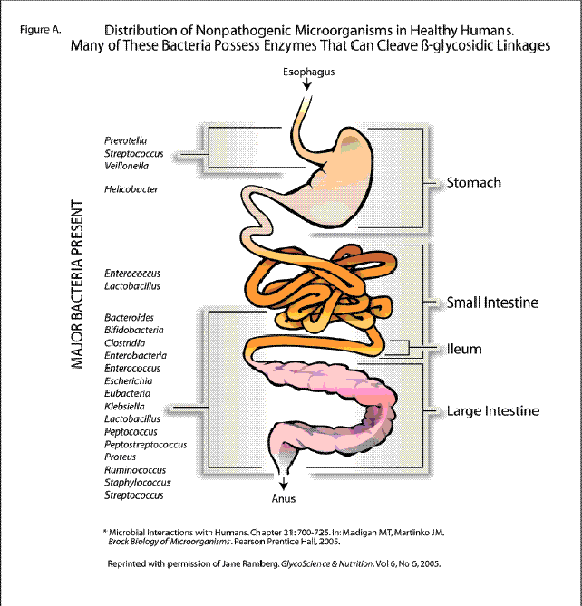
Food for thought: Nourishing mental well-being in vocational training
Erasmus+ 2025-1-ES01-KA210-VET-000358116

Slide 39
Gut Microbiota and Functions
A newborn baby has a sterile gut that is colonized by bacteria from the mother and from the baby’s surroundings or environment.
The composition and complexity of the gut microbiota changes when the baby is weaned to solid foods.
Dietary changes in adulthood are also greatly responsible for the composition of gut microbiota.
Food for thought: Nourishing mental well-being in vocational training
Erasmus+ 2025-1-ES01-KA210-VET-000358116

Slide 40
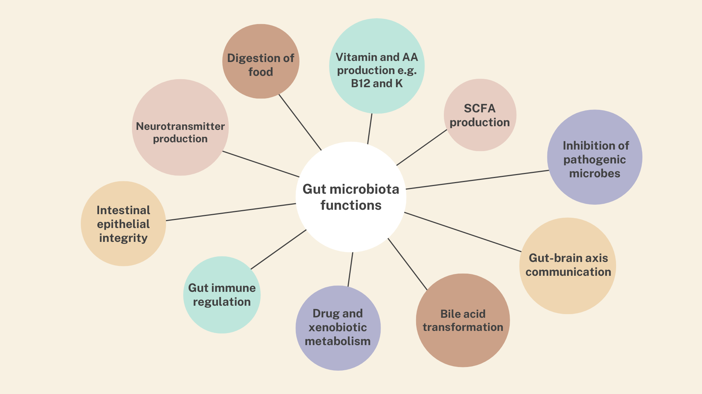
Notes:
My own graphic

Slide 41
1. Structure and Histological Functions
The intestinal structure and function is ensured by the microbiota present within.
The intestinal mucus layer is a balance of Mucin secretion and degradation. This Mucin layer creates an obstacle to proinflammatory compounds and uptake of antigens.
Evidence indicates that butyrate induces secretion of Mucin, antimicrobial peptides, and other factors which reinforces the defense barrier in the colon.
Food for thought: Nourishing mental well-being in vocational training
Erasmus+ 2025-1-ES01-KA210-VET-000358116

Slide 42
Secondly, the gut microflora has a role in the development of cell and tissue.
Butyrate, a short chain fatty acid that is secreted by these colonic microbes, regulates cell growth and differentiation, inhibits transformation of cell growth and helps in reverting the cells from a neoplastic to a nonneoplastic phenotype.
The development of the microvasculature of the intestinal villi is dependent on the indigenous microbes.
Food for thought: Nourishing mental well-being in vocational training
Erasmus+ 2025-1-ES01-KA210-VET-000358116

Slide 43
2. Metabolic Functions
The gut bacteria are known to produce a large number of vitamins like the B group of vitamins, synthesize amino acids, and carry out biotransformation (alteration) of the bile.
Biotransformation of bile by microbial enzymes is important for the metabolism of glucose and cholesterol.
The microbiome provides the much needed biochemical pathways for the fermentation of nondigestible substrates like fibers and endogenous mucus.
Fermentation or metabolism of these nondigestible substrates leads to the growth of these microbes and the production of short chain fatty acids (SCFA’s) and gases.
The major SCFA’s produced are acetate, propionate, and butyrate.
Other bacterial end products include lactate, ethanol, succinate, formate, valerate, caproate, isobutyrate, 2-methyl-butyrate, and isovalerate.
Food for thought: Nourishing mental well-being in vocational training
Erasmus+ 2025-1-ES01-KA210-VET-000358116

Slide 44
Bacterial fermentation takes place in the cecum and colon, where the short-chain fatty acids are absorbed, stimulating the absorption of salts and water.
These short-chain fatty acids have a protective effect on the intestinal epithelium.
The principal short chain fatty acid produced in the colon is acetate, and it serves as a substrate for biosynthesis of cholesterol.
Thus the gut microbiota performs various metabolic acitivities which are essential for the host’s metabolism.
Food for thought: Nourishing mental well-being in vocational training
Erasmus+ 2025-1-ES01-KA210-VET-000358116

Slide 45
3. Protective Functions
Many of the commensal organisms produce antimicrobial compounds and compete for nutrients and sites of attachment in the gut lining, thereby preventing colonization by pathogens.
This helps reduce the production of lipopolysaccharides and peptidoglycans which can all be detrimental to the host.
Germ free animals have fewer dendritic cells, and evidence shows that bacterial systems have a role to play in development of B cells.
The development of regulatory T cells, T helper type 1 and 2 cells, and T helper 17 cells is also dependent on the signals given by the intestinal bacteria.
Short-chain fatty acids, such as butyrate, have been shown to inhibit NF-kB in patients with ulcerative colitis thus exerting immunomodulatory effects.
Food for thought: Nourishing mental well-being in vocational training
Erasmus+ 2025-1-ES01-KA210-VET-000358116

Slide 46
The intestinal mucosa prevents threats by signaling to the innate immune system through toll-like receptors.
These recognize and bind to specific microbial macromolecules, like lipopolysaccharide, flagellin, peptidoglycan, and N-formylated peptides.
In the intestinal mucosa, the activation of toll-like receptors initiates nuclear factor-kB pathways, mitogen-activated protein kinase, and caspase-dependent signaling cascades.
These lead to the production and release of protective peptides, cytokines, chemokines, and phagocytes. The result can be a protective response to commensal bacteria, an inflammatory response to pathogenic organisms, or a trigger of apoptosis.
Food for thought: Nourishing mental well-being in vocational training
Erasmus+ 2025-1-ES01-KA210-VET-000358116

Slide 47
Dysbiosis and Modulation of Gut Microbiota
Any changes to this microbial ecosystem could cause an imbalance or dysregulation of the microbiota (dysbiosis) often associated with various disease states ranging from the most common IBD and IBS to the more unexpected activation of chronic human immunodeficiency virus (HIV) infection and generation of atopy.
It is therefore important to reestablish the bacterial homeostasis which may have been disturbed by any or several factors.
Food for thought: Nourishing mental well-being in vocational training
Erasmus+ 2025-1-ES01-KA210-VET-000358116

Slide 48
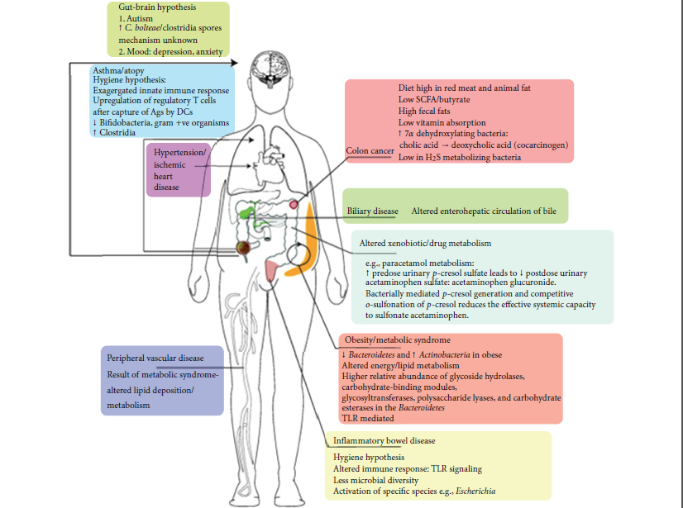
Food for thought: Nourishing mental well-being in vocational training
Erasmus+ 2025-1-ES01-KA210-VET-000358116

Slide 49
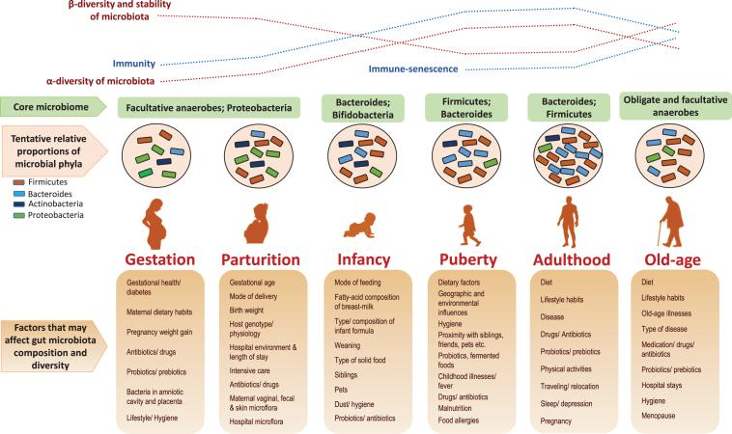
Changes in the gut microbiota over life
Nagpal R et al. Nutr Healthy Aging 2018;4:267-85
Food for thought: Nourishing mental well-being in vocational training
Erasmus+ 2025-1-ES01-KA210-VET-000358116
Notes:
Link to the paper where the graphic has been attributed to is here https://www.ncbi.nlm.nih.gov/pmc/articles/PMC6004897
As per the copyright and license statement in the paper, this is an open access article distributed under the terms of the Creative Commons Attribution Non-Commercial (CC BY-NC 4.0) License, which permits unrestricted non-commercial use, distribution, and reproduction in any medium, provided the original work is properly cited.

Slide 50
The gut microbiota plays an important role in the regulation of many aspects of health and disease
The effect of probiotic supplementation has been studied in a wide range of conditions and in a large number of studies, including:
gastrointestinal conditions,
atopic eczema in children,
allergies,
respiratory tract infection,
obesity,
metabolic disease/ type 2 diabetes,
cardiovascular disease,
cognitive and mental health and
bone health.
Food for thought: Nourishing mental well-being in vocational training
Erasmus+ 2025-1-ES01-KA210-VET-000358116

Slide 51
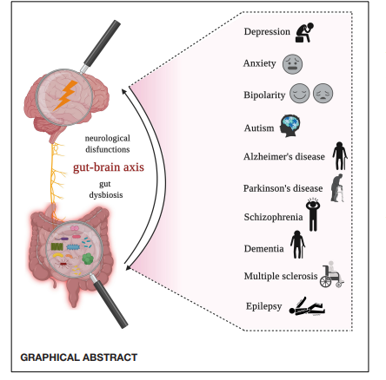
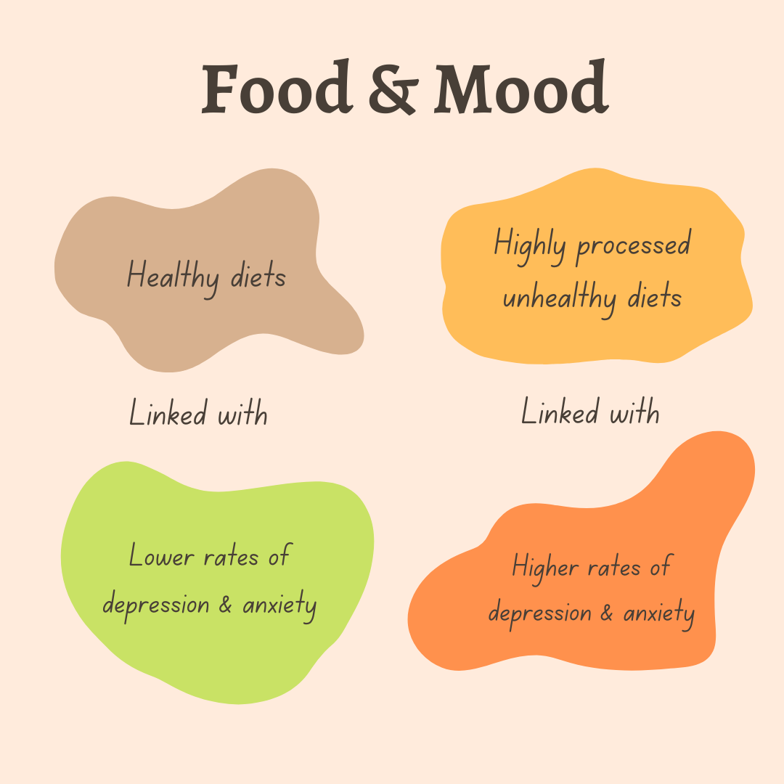
(source: Mitrea et al., 2022)
How food can improve your mental health
Food for thought: Nourishing mental well-being in vocational training
Erasmus+ 2025-1-ES01-KA210-VET-000358116

Slide 52
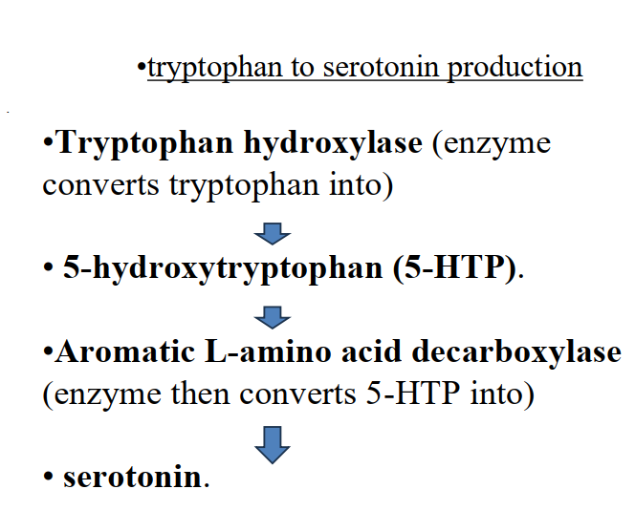
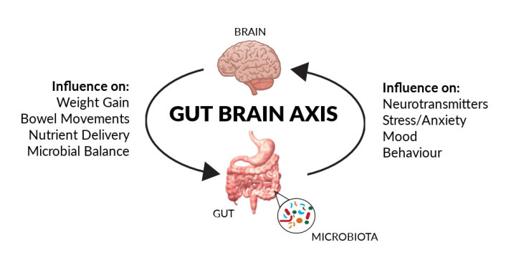
The gut microbiome, diet and mental health connection
Food for thought: Nourishing mental well-being in vocational training
Erasmus+ 2025-1-ES01-KA210-VET-000358116

Slide 53
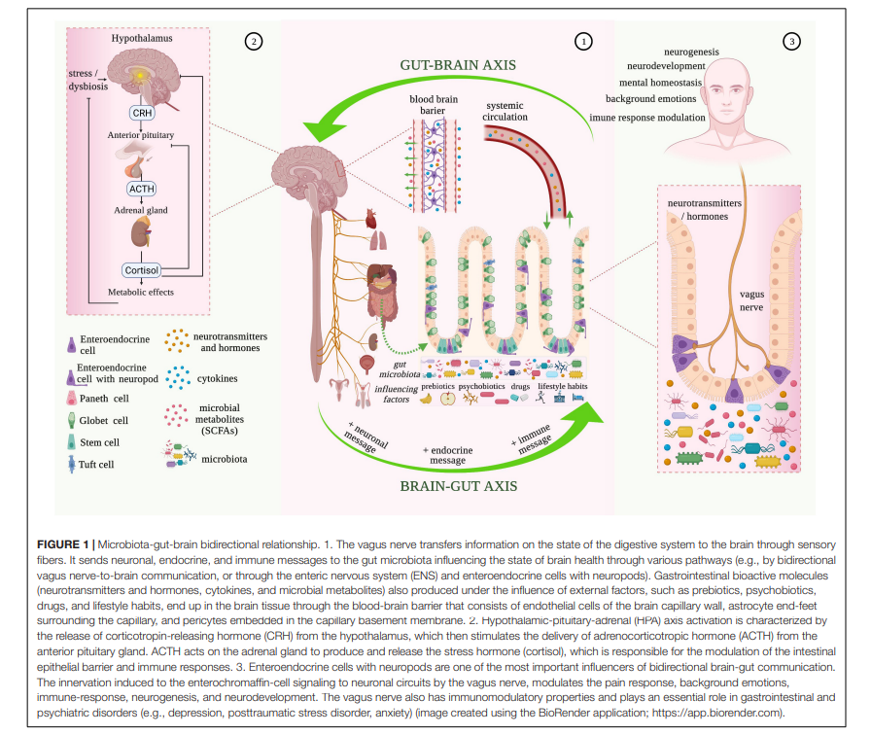
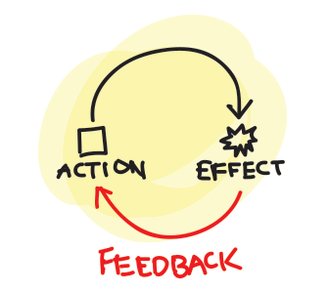
Food for thought: Nourishing mental well-being in vocational training
Erasmus+ 2025-1-ES01-KA210-VET-000358116

Slide 54
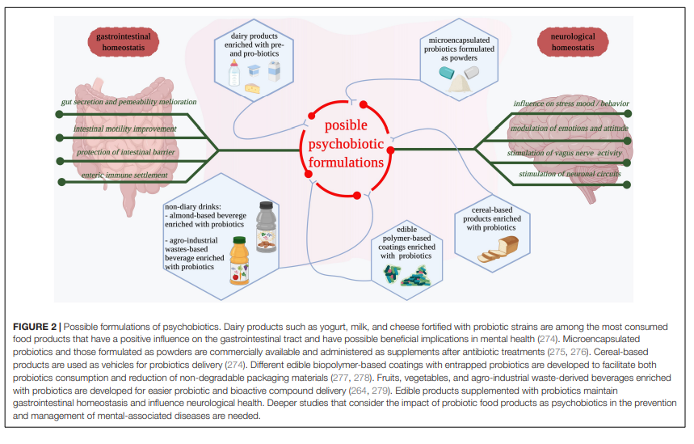
(source: Mitrea et al., 2022)
Food for thought: Nourishing mental well-being in vocational training
Erasmus+ 2025-1-ES01-KA210-VET-000358116

Slide 55

What you eat can affect your mood
But your mood also influences what you choose to eat
People in a good mood are more likely to choose nutritious foods and to focus on the long-term benefits of these healthy foods
People who follow traditional diets, like the Mediterranean and the Japanese diets, have a one-third lower risk of depression compared to those following a typical Western diet
Food for thought: Nourishing mental well-being in vocational training
Erasmus+ 2025-1-ES01-KA210-VET-000358116

Slide 56
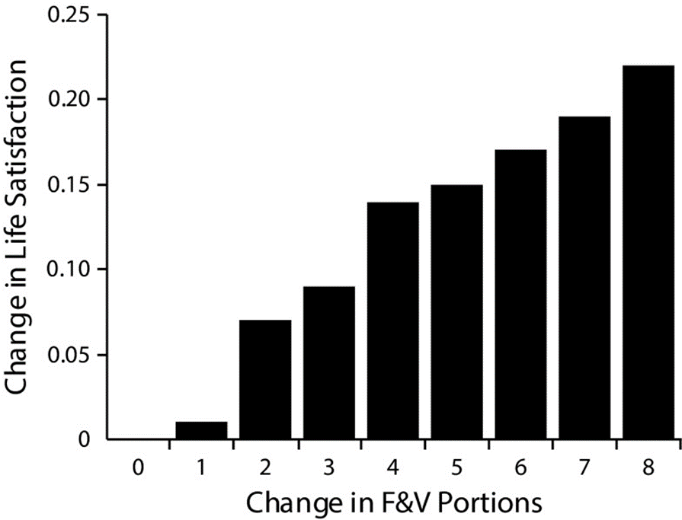



Fruits, vegetables and happiness
12,000 Australians had their diet, health and happiness tracked from 2009 to 2013
Happiness, life satisfaction and well-being all went up for each extra daily portion of fruits and vegetables eaten
Going from eating no fruits and vegetables to 8 servings a day = ↑ in life satisfaction equivalent to moving from unemployment to employment
Mujcic R and Oswald AJ. Am J Public Health 2016;106:1504-1510
Food for thought: Nourishing mental well-being in vocational training
Erasmus+ 2025-1-ES01-KA210-VET-000358116

Slide 57
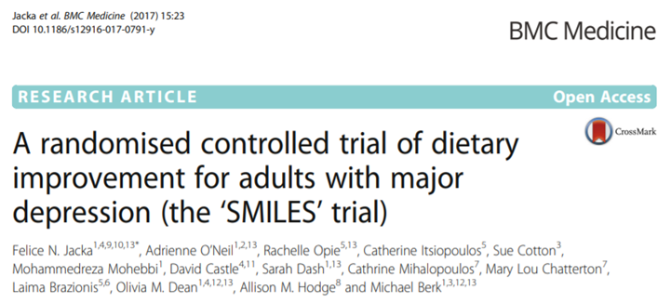
The SMILES Trial
67 people with moderate to severe depression
12 weeks of diet counselling versus a control group in a social support group, but no diet advice
Dietary advice was about having more wholegrains, fruits, vegetables, nuts, legumes, lean meat, chicken and seafood and less highly refined starches, sugar and highly processed foods
Significant improvement in depression in the diet group
One third of people in the diet group achieved clinical remission from their depression compared to just 8% in the control group
Food for thought: Nourishing mental well-being in vocational training
Erasmus+ 2025-1-ES01-KA210-VET-000358116

Slide 58
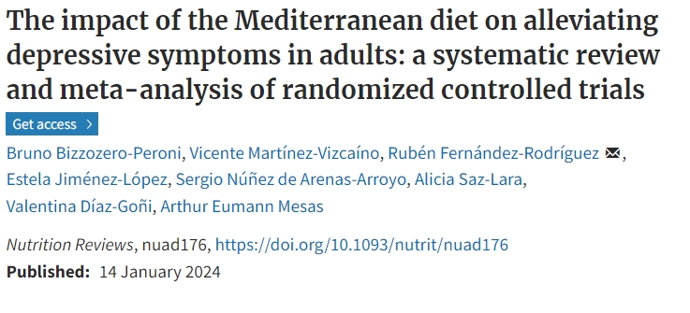
Mediterranean diet and depression
Systematic review of 5 clinical trials that used the Mediterranean diet versus a control diet to treat symptoms of depression
Involved 1,507 adults with major or mild-to-moderate depression
Saw a significant reduction in depression symptoms
Mechanism
Fibre, vitamins, minerals, polyphenol and omega-3 content of the diet
Antioxidant and anti-inflammatory effects
Direct brain effects on brain plasticity by ↑ BDNF production
Gut microbiota changes
Food for thought: Nourishing mental well-being in vocational training
Erasmus+ 2025-1-ES01-KA210-VET-000358116

Slide 59
Millets and Serotonin Production
The production of serotonin is highly dependent on the availability of its precursor, tryptophan
Key Benefits of Millets for Serotonin Production:
•High in tryptophan,
  •the precursor for serotonin.
•Supports gut microbiota
  •, which aids in serotonin synthesis.
  •Reduces inflammation,
  • Promotes a healthy gut environment for serotonin production.
  •Balances blood sugar levels,
  •indirectly supporting serotonin regulation.
Food for thought: Nourishing mental well-being in vocational training
Erasmus+ 2025-1-ES01-KA210-VET-000358116

Slide 60
Mechanism Summary of Serotonin Production in the Gut with Millets:
Gut-Brain Axis Activation:
  Serotonin in the gut activates the vagus nerve, sending signals to the brain that influence mood and cognition.
Blood Sugar Stability:
  The low glycemic index of millets supports balanced serotonin levels by preventing fluctuations in blood sugar.
Food for thought: Nourishing mental well-being in vocational training
Erasmus+ 2025-1-ES01-KA210-VET-000358116

Slide 61
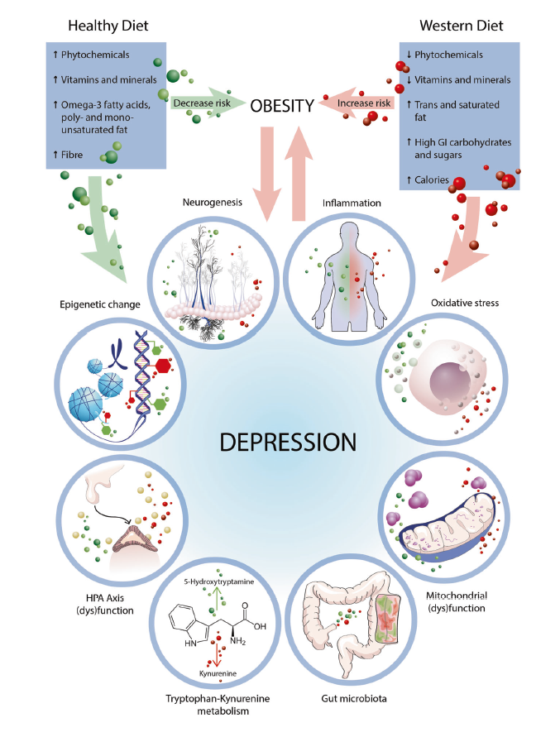
Nutrition, inflammation & depression
Part of the body's normal response to protect against infection, injury or disease.
Involves several parts of our immune system from the activation of white blood cells to the release of chemical inflammatory mediators.
Without inflammation, wounds and infections would never heal so it is something we need, but too much is not good for our health.
Acute inflammation happens quickly following an injury like a splinter in your finger or an infection.
Chronic inflammation involves an ongoing body defense response that can end up damaging blood vessels and other body tissues, accelerating development of long-term health problems.
Marx W et al. Mol Psychiatry 2021;26:134-150
Food for thought: Nourishing mental well-being in vocational training
Erasmus+ 2025-1-ES01-KA210-VET-000358116

Slide 62
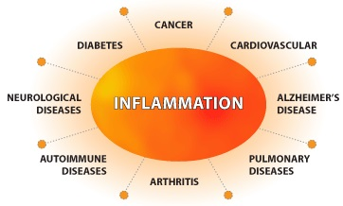
Causes of chronic inflammation
Autoimmune diseases (e.g rheumatoid arthritis, lupus);
Infections;
Cardiovascular disease;
Environmental factors (smoking, pollution);
Allergies;
Obesity (especially excess abdominal fat);
Ageing;
Smoking;
Sedentary lifestyle;
Poor sleep;
Poor diet.
Food for thought: Nourishing mental well-being in vocational training
Erasmus+ 2025-1-ES01-KA210-VET-000358116

Slide 63
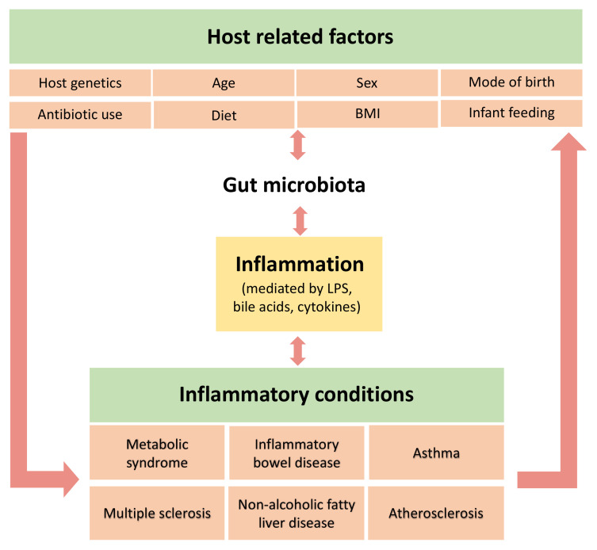
Gut health and chronic inflammation
Disorders that cause changes in the gut microbiota can lead to an imbalance in immune regulation.
By-products of metabolic processes of bacteria in the gut can play a role in inhibiting inflammation.
Because of the connection between the gut microbiota and inflammation, fibre is one of the best ‘anti-inflammatory foods’ you can eat.
An ‘anti-inflammatory diet’ is one high in fruits, vegetables, healthy fats, legumes and wholegrains.
A Mediterranean-style diet would be one example of this especially when you add in fish (for the omega-3s) and olive oil.
Such a diet is high in antioxidants, anti-inflammatory compounds and prebiotic fibre.
Bander ZA et al. Int J Res Public Health 2020;17:7618
Food for thought: Nourishing mental well-being in vocational training
Erasmus+ 2025-1-ES01-KA210-VET-000358116

Slide 64
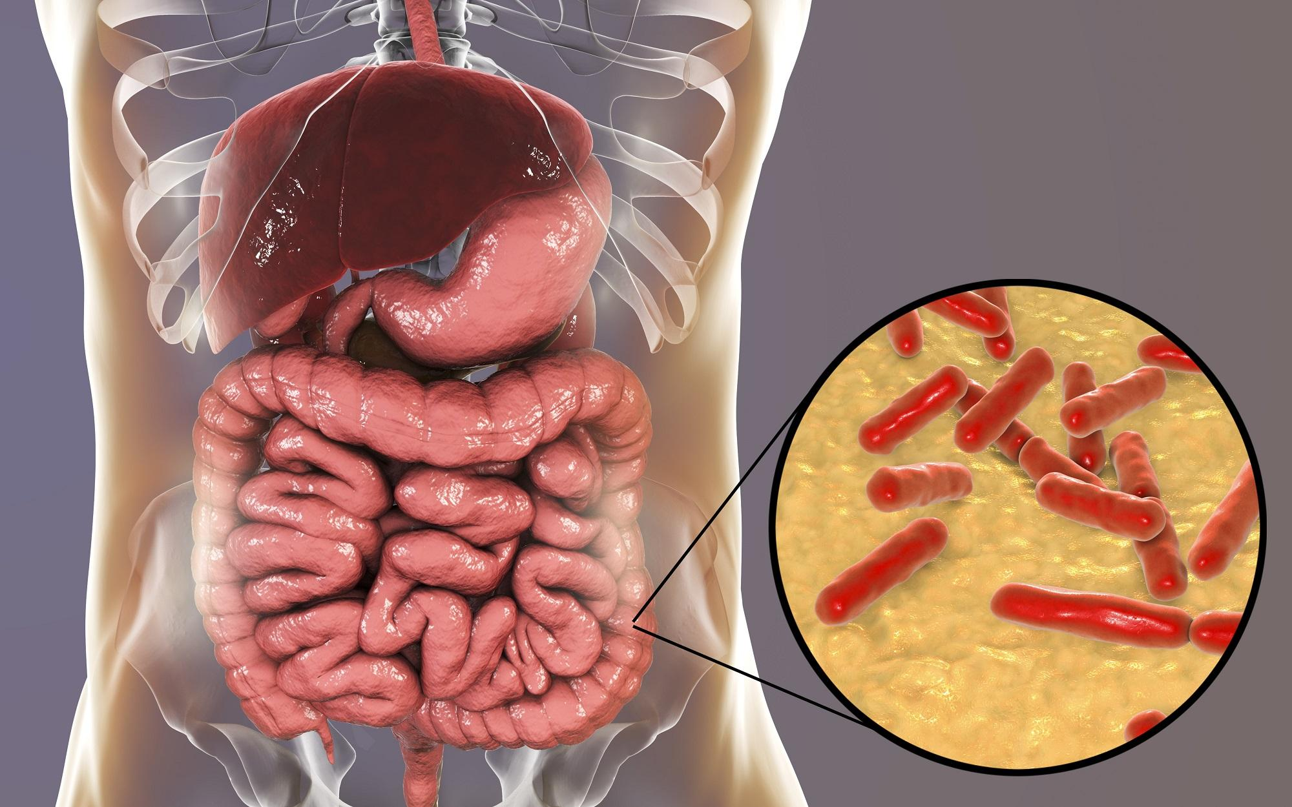
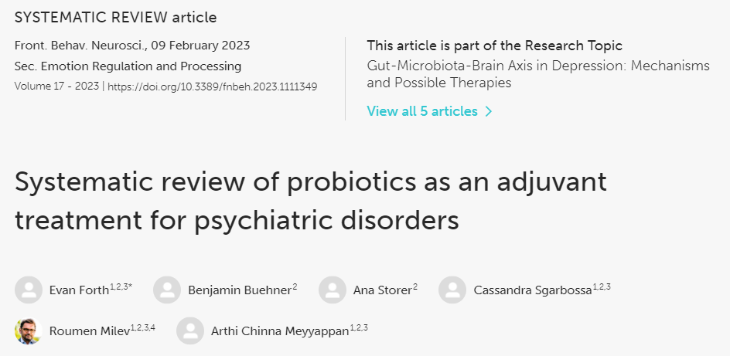
Probiotics and mental health
Review of 8 clinical trials (5 with depression, 1 with anxiety, 2 with schizophrenia)
Additive benefit on SSRI use for depression and anxiety
Improved tolerability of antipsychotic medication
Food for thought: Nourishing mental well-being in vocational training
Erasmus+ 2025-1-ES01-KA210-VET-000358116

Slide 65
Exemple of probiotics
Microorganisms | Genus | Species
Bacteria | Lactobacillus | L.acidophilus, L.brevis, L.reuteri, L.casei, L.rhamnosum, L.bulgaricus, L.cellobiosus, L.delbrueckii, L. fermentum.
 | Bifidobacterium | B.thermophilus, B.infantis, B .longum, B.bifidum, B.animalis.
 | Streptococcus | S.lactis, S.thermophilus, S.cremonis, S.alivarius.
 | Bacillus | B.Coagulans
 | Pediococcus | P.acidilactici
 | Leuconostoc | L.mesenteroides
 | Enterobacter | E.faecium, E.faecalis.
Fungi | Aspergillus | A.niger, A.oryzae.
Yeast | Saccharomyces | S.boulardii, S.cerevisiae, S.carlsbergensis.
Food for thought: Nourishing mental well-being in vocational training
Erasmus+ 2025-1-ES01-KA210-VET-000358116

Slide 66
Properties of probiotics
It should be safe to the host.
It should not produce any pathogenic or toxic effect.
It must be resistance to hydrochloric acid, bile and pancreatic juice.
It should have anti-carcinogenic activity.
It should produce lactic acid.
It should retain viability during storage and use.
It should stimulate the immune system of the body.
It should have the ability to colonize the gastrointestinal tract.
Food for thought: Nourishing mental well-being in vocational training
Erasmus+ 2025-1-ES01-KA210-VET-000358116

Slide 67
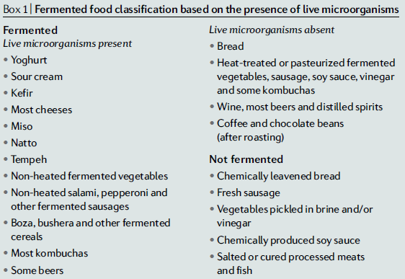
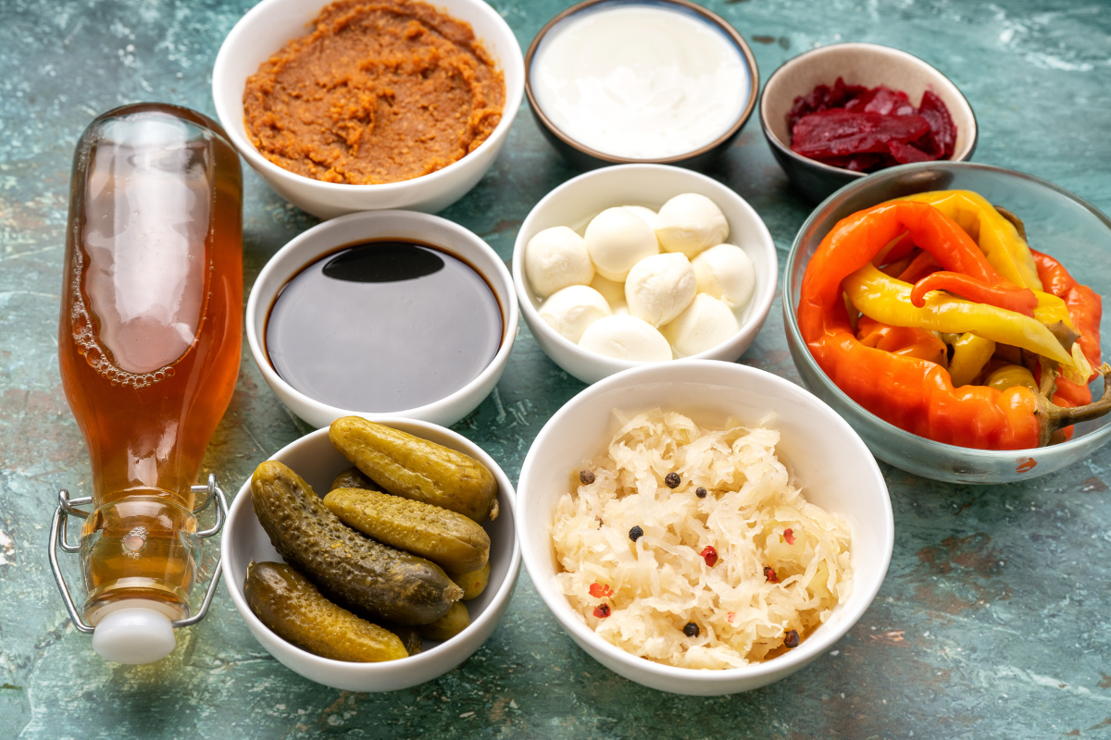
Fermented foods as source of probiotics
Marco ML et al. Nat Rev Gastroenterol Hepatol 2021;18:196-208
Food for thought: Nourishing mental well-being in vocational training
Erasmus+ 2025-1-ES01-KA210-VET-000358116

Slide 68
Factor affecting probiotic bacteria
Intrinsic as well as extrinsic factors may influence the survival of probiotics in food.
Important factor affecting viability of probiotics are:
Physical condition (temperature and humidity).
Chemical condition (content of oxygen nitrogen or pH).
Food for thought: Nourishing mental well-being in vocational training
Erasmus+ 2025-1-ES01-KA210-VET-000358116

Slide 69
Prebiotics ensure the support for probiotic activity
Oligosaccharide is the main constituent of prebiotic food products.
Oligosaccharides stimulate the growth of benefic bacteria and increase the resistance to invading pathogens.
The functional oligosaccharides include;
Fructooligosaccharides (FOS).
Glucooligosaccharides(GOS)
Inulin
Isomaltooligosaccharides (IMO)
Soybeanmeal oligosaccharides (SMO)
Mannan oligosaccharides(MOS)
Galactooligosaccharides
Maltooligosaccharides (MO)
Xylooligosaccharides (XOS)
Pectin-derived acidic oligosaccharides (pAOS).
How do they work?
Increase a number of bifidobacterium and lactic acid bacteria.
Effect on the metabolism of lipids.
Suppression of putrefactive bacteria.
Growth of bifidobacteria.
It helps to lower colon cancer risk.
Food for thought: Nourishing mental well-being in vocational training
Erasmus+ 2025-1-ES01-KA210-VET-000358116

Slide 70
USES OF PREBIOTICS
Enhance bone density and increase Calcium absorption.
Improve immune function in both the gut and body.
Establish a healthier balance of bacteria in the gut.
Promote regular bowel movements.
Suppress appetite.
Reduces the risk of an intestinal infection.
Increase in mineral absorption and improvement of bone health.
Modulation of gastro-intestinal peptides production, energy metabolism and satiety.
Initiation (after birth) and regulation/modulation of immune functions.
Food for thought: Nourishing mental well-being in vocational training
Erasmus+ 2025-1-ES01-KA210-VET-000358116

Slide 71
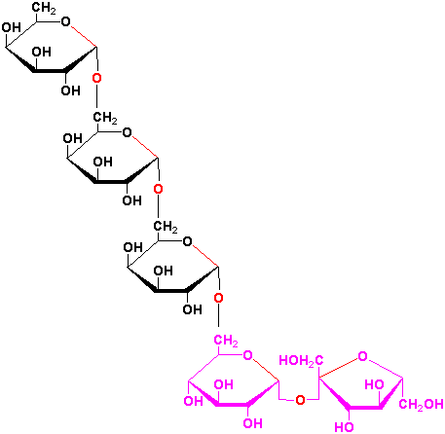
SOURCES OF PREBIOTICS
Prebiotics factor | Origin
Oligosaccharides | Onion,garlic,chicoryroot,yacon, asparagus, jerusalem, artichoke, soybean, wheat bran.
Fructo-oligosaccharides (oligofructose,inulin) | Same as for oligosaccharides.
Fructans | Ash free white powder from the tubers of jerusalem artichoke.
Human kappa casein and derived glycomacropeptide | Human milk: chymotrypsin and pepsin hydrolysate.
Stachyose and raffinose | Soybean extract.
Casein macropeptide | Bovine milk.
Lactitol (4-O-β-D- galactopyranosyl)/ D- glucitol | Systhetic sugar alcohol of lactose.
Lactulose (4-O-β-D- galacyopyranosyl) / D-fructose | Synthetic derivative of lactose.
Food for thought: Nourishing mental well-being in vocational training
Erasmus+ 2025-1-ES01-KA210-VET-000358116

Slide 72
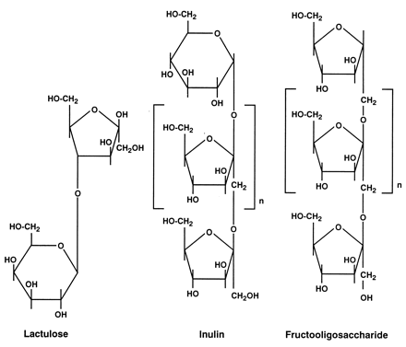
FRUCTO-OLIGOSACCHARIDE
Fructooligosaccharides is a group of oligosaccharides, or a group of connected simple sugars.
Sources include onions and chicory root also garlic.
It helps in the stimulate production of beneficial bacteria, minimal effect on blood sugar, also help strengthen the immune system.
Food for thought: Nourishing mental well-being in vocational training
Erasmus+ 2025-1-ES01-KA210-VET-000358116

Slide 73
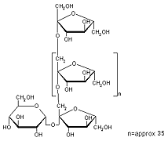
INULIN
Inulin is a dietary fibre that is found in many common foods such as leeks, kiwi, asparagus, onions, garlic, bananas, wheat, rhubarb, dairy products etc.
There are several benefits of inulin apart from weight-management, it even increases calcium absorption, improved bone health. It can also be used to replace sugar and fat as a food additive to improve taste.
Food for thought: Nourishing mental well-being in vocational training
Erasmus+ 2025-1-ES01-KA210-VET-000358116

Slide 74
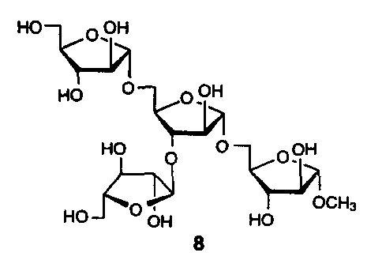
SOYBEAN-OLIGOSACCHARIDE
They found in soy milk, soy oil,bean curd, ice cream.
Promote the growth of Bifidobacteria in the intestinal tract,lowering cholesterol.
Food for thought: Nourishing mental well-being in vocational training
Erasmus+ 2025-1-ES01-KA210-VET-000358116

Slide 75
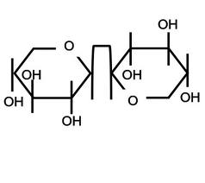
XYLO-OLIGOSACCHARIDE
They are naturally present in fruits, vegetables, bamboo, milk and honey.
It help to improve blood sugar levels and fat absorption, re-establish normal colonic flora , it also increase mineral absorption and vitamin B creation.
Food for thought: Nourishing mental well-being in vocational training
Erasmus+ 2025-1-ES01-KA210-VET-000358116

Slide 76
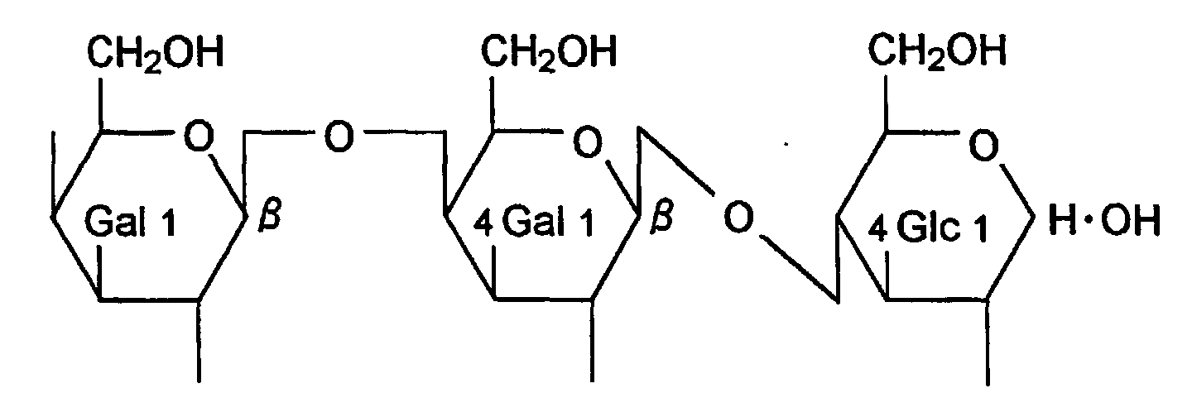
GALACTO-OLIGOSACCHARIDE
Galacto-oligosaccharides, otherwise called( GOS), are found naturally in breast milk but are added to foods such as infant formula, fruit drinks, dairy products, breakfast cereals and biscuit crackers.
Increased the good bacteria boosts the immune system.
Promote intestinal health by keeping unfriendly bacteria such as E.coli, vaginal, urinary infections at bay.
Food for thought: Nourishing mental well-being in vocational training
Erasmus+ 2025-1-ES01-KA210-VET-000358116

Slide 77
Role of prebiotic
Prebiotic factor | Origin | Microbes stimulated | Effects
Oligosaccharides | Onion,garlic, chicory root, burdock, asparagus, Jerusalem artichoke, soybean, wheat bran. | Bifidobacterium species | Increase in bifidobacterium, suppression of putrefactive bacteria, prevention of constipation and diarrhea.
Fructooligosaccharides (inulin, oligofructo) | Same as for oligosaccharides | Bifidobacterium species Lactobacillus acidophilus, Lactobacillus casei, Lactobacillus plantarum | Growth of bifidobacteria and acid promotion.
Fructan | Ash-free white powder from tubers of Jerusalem artichoke. | Bifidobacterium species | Growth of bifidobacteria
Human kappa casein and derived glycolmacropeptide | Human milk: chymotrypsin and pepsin hydrolysate. | Bifidobacterium bifidum | Growth promotion.
Stachyose and raffinose | Soybean extract | Bifidobacterium species | Growth factor.
Casein macropeptide | Bovine milk | Bifidobacterium species | Growth promotion.
Lactitol(4-O-β-D-galactopyranosyl)D-glucitol | Synthetic sugar alcohol of lactose | Bifidobacterium species | Growth promotion.
Lactutose(4-O-β-D-galactopyranosyl)D-fructose | Synthetic derivative of lactose | Bifidobacterium species | Growth promotion.
Food for thought: Nourishing mental well-being in vocational training
Erasmus+ 2025-1-ES01-KA210-VET-000358116

Slide 78
Health Benefits Prebiotic
Immune System Strength: Prebiotic fiber promotes the growth and colonization of beneficial bacteria in the gut. These bacteria aid the immune system in fighting illness-causing bacteria and viruses.
Normal Bowel Function: Irritable bowel syndrome, which is characterized by bloating, gas, stomach pain, cramping, bouts of constipation and diarrhea, is caused by food being digested improperly. , prebiotic fiber causes foods to be digested normally, over a normal period of time, not too quickly or too slowly.
Cancer Prevention:Bifidobacteria digests inulin in the gut flora and produces short chain fatty-acids: acetic acid, propionic acid, and butyric acid. Within the intestine, it is believed that these acids can help prevent certain forms of cancer.
Colon cancer: The insoluble fiber from prebiotics, some experts believe, are actually doing a part in preventing colon cancer by sweeping up carcinogens and other dangerous toxins before they can be absorbed into the bloodstream where they can do damage.
Food for thought: Nourishing mental well-being in vocational training
Erasmus+ 2025-1-ES01-KA210-VET-000358116

Slide 79
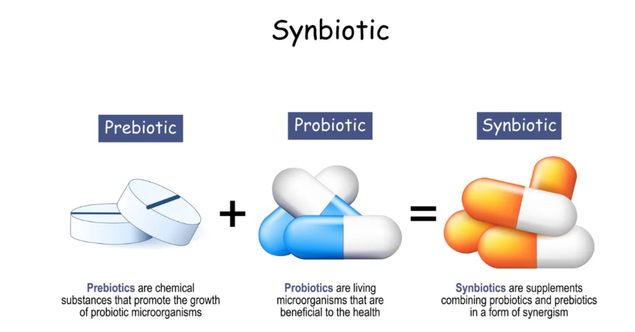
Synbiotics
Synbiotics is a combination of probiotics and prebiotics administered together.
Examples:
Bifidobacteria and fructo-oligosaccharides (FOS);
Lactobacillus rhamnosus GG and inulins;
Bifidobacteria or lactobacilli with FOS or inulins or galactooligosaccharides (GOS).
Food for thought: Nourishing mental well-being in vocational training
Erasmus+ 2025-1-ES01-KA210-VET-000358116

Slide 80
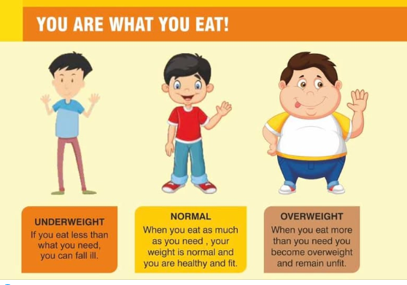
Conclusions
If you are struggling with your mental health, reach out for help.
It can be hard to eat well when you are feeling down. Know that each positive step you take to eating better is a step in the right direction for your mental health.
Fruits, vegetables, wholegrains, nuts, legumes and fish are the cornerstone of a diet for good mental health.
Food for thought: Nourishing mental well-being in vocational training
Erasmus+ 2025-1-ES01-KA210-VET-000358116

